Slide 1



Oxygen Production on the Archean Landmass
Kurt Konhauser
Earth & Atmospheric Sciences
University of Alberta
Stefan Lalonde
CNRS-UMR6538 Domaines Océaniques
European Institute for Marine Studies

Slide 2
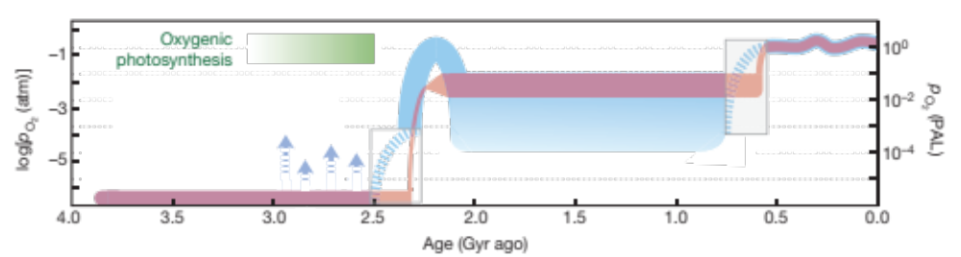
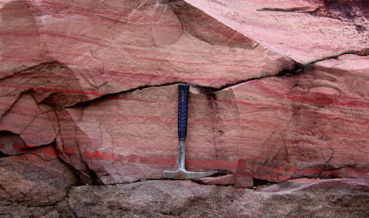
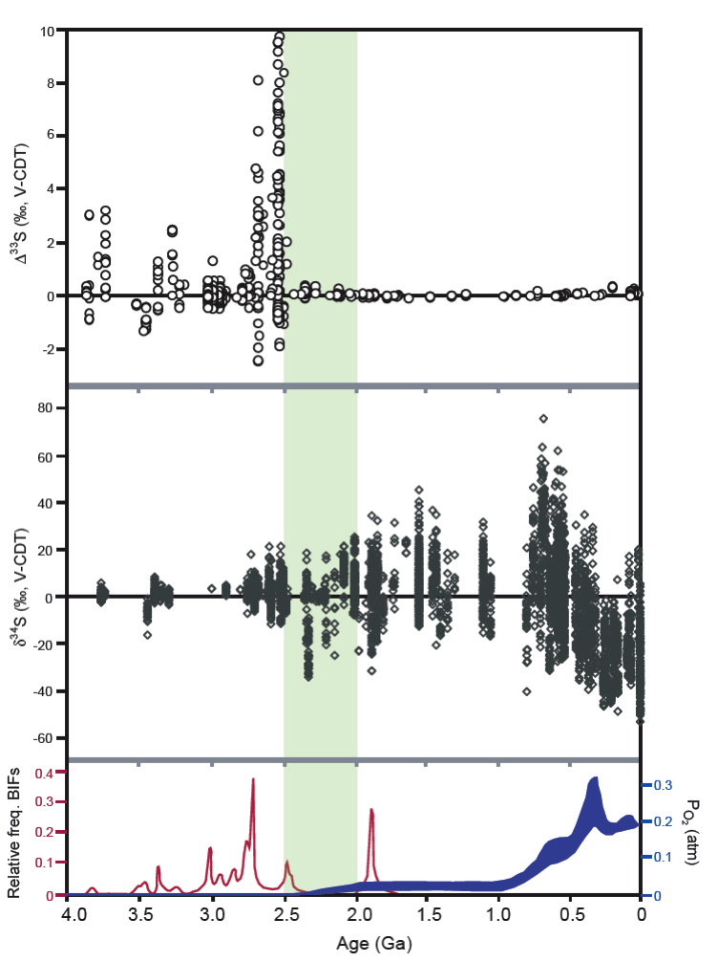
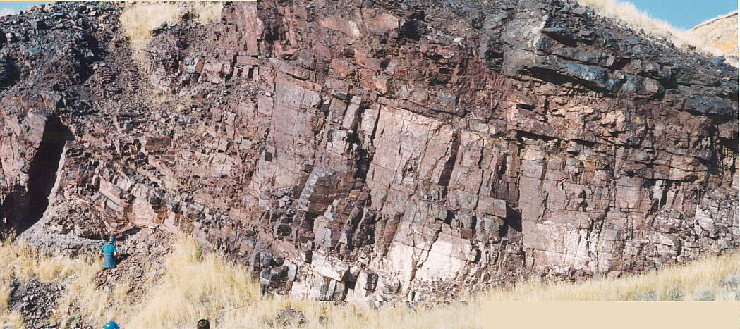
The Great Oxidation Event
Great Oxidation Event
Lyons et al. (2014), Nature
Farquhar et al. (2011), Photosynthesis Research
Kump (2008), Nature
Lyons et al. (2014), Nature
Notes:
2

Slide 3
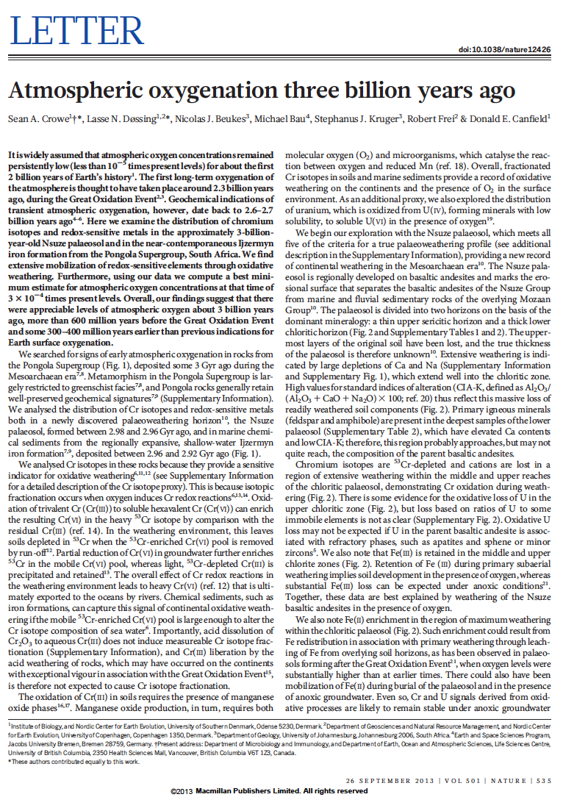
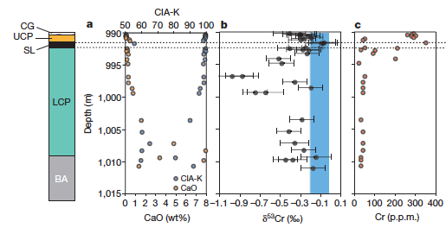
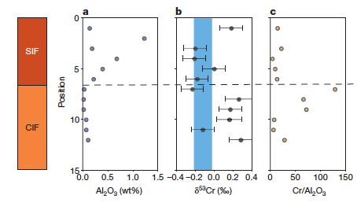
Oxygen at 3 billion years? Atmospheric or Not?
By comparing the Cr concentrations and isotopes between the 2.96 Ga paleosols (above) and 2.95 BIF (below), it was suggested that oxidative weathering already took place on land at that time, leaving behind a –δ⁵³Cr reservoir in the soils and a +δ⁵³Cr reservoir in the marine sediment.

Slide 4
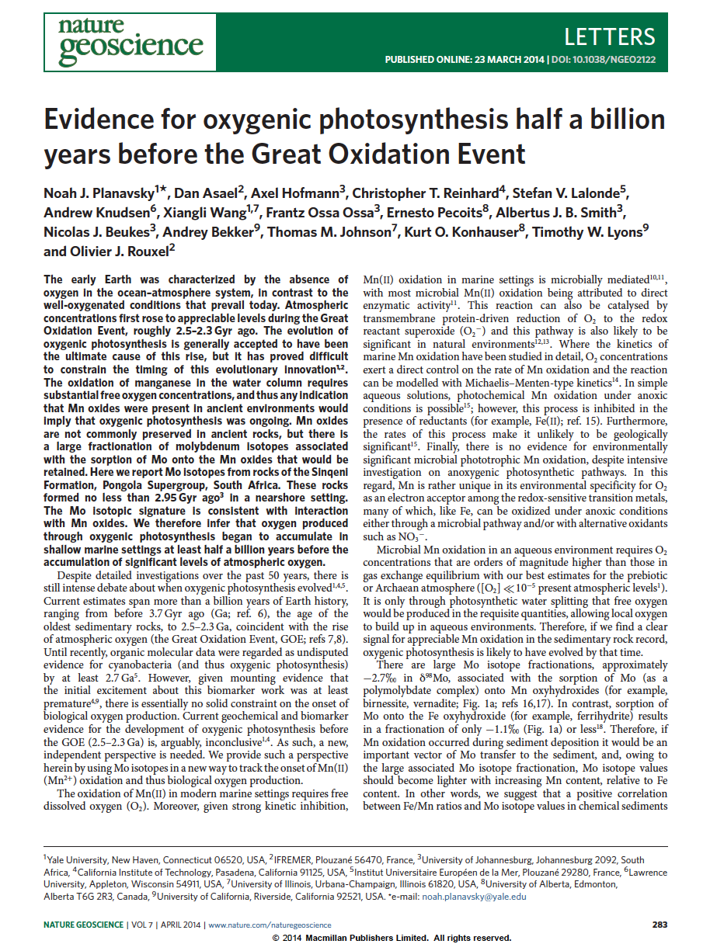
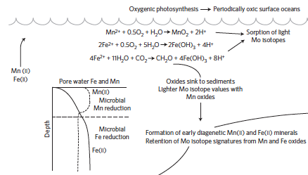
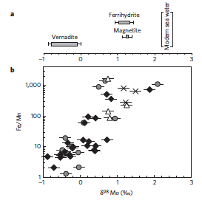
Oxygen at 3 billion years? Atmospheric or Not?
Owing to the large associated Mo isotope fractionation associated with Mo sorption to Mn(IV) oxides, Mo isotope values should become lighter with increasing Mn content, relative to Fe content. In other words, a positive correlation is expected between Fe/Mn ratios and Mo isotope values in chemical sediments (i.e., BIF), providing compelling evidence for Mn(II) oxidation in the environment.

Slide 5
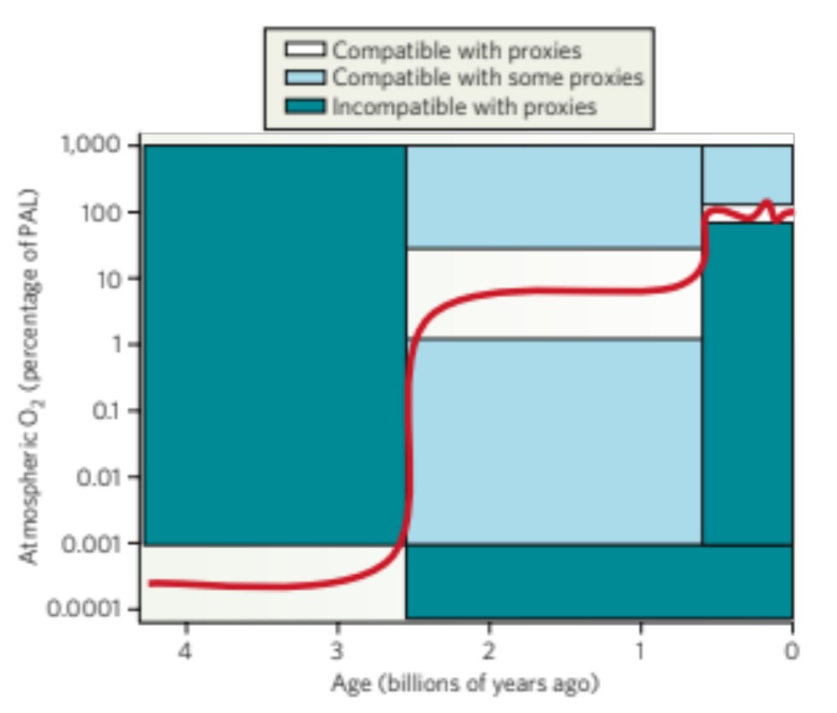
Is Oxidative Weathering at Low O₂ Possible?
?
Kump (2008), Nature
The superposition of pre-GOE signals for oxidative weathering at a time of a generally anoxic atmosphere represents a conundrum that two models have been generally accepted to resolve: (1) pre-GOE oxidative weathering is the result of transient oxygenation events (i.e., “whiffs”) driven by “oxygen oases” in the marine realm, and (2) oxidative weathering proceeded at atmospheric O₂ concentrations below 10⁻⁵ present atmospheric level (PAL). We (Lalonde and Konhauser, PNAS in revision) propose a twist on the 2nd model in that we had intense O₂ generation – and immediate consumption – at sub-meter scales by benthic oxygenic photosynthesis in the terrestrial realm.

Slide 6
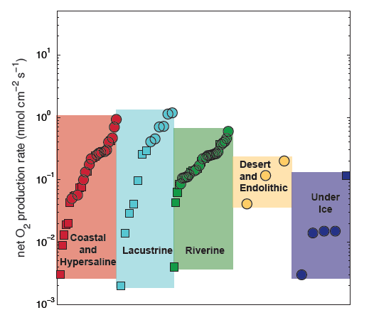
Benthic O₂ Production
Courtesy of Tanja Bosak
Nowhere on the modern Earth is free molecular oxygen found in greater excess than in benthic photosynthetic ecosystems. Gross oxygenic photosynthetic activity is 1,000 to 10,000 fold greater by volume in benthic communities relative to pelagic ones. In other words, 1 mm of microbial mat may display photosynthetic activity that is comparable in the pelagic realm to a 10 m deep water column. In-situ measurements of oxygenic photosynthesis in benthic microbial ecosystems (O₂ produced – O₂ immediately consumed) generally fall within two orders of magnitude (10⁰ – 10⁻² nmol cm⁻² s⁻¹) regardless of the benthic environment.

Slide 7
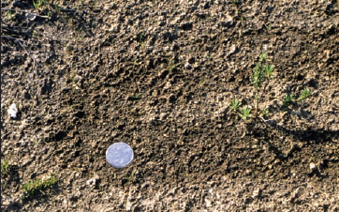
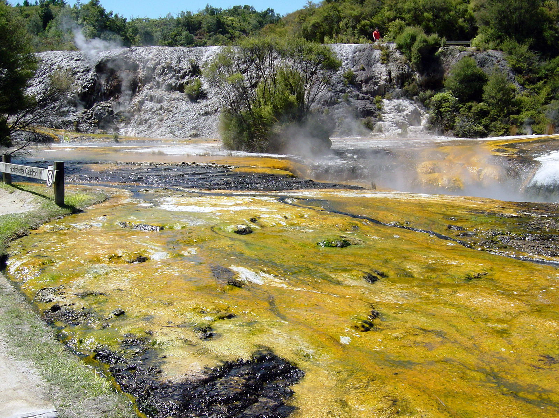
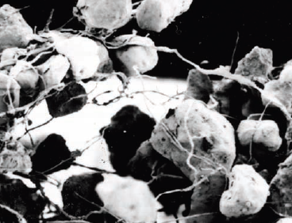
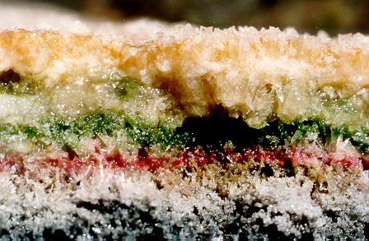
Modern O₂ Oases
Biological Soil Crusts (BSCs)
Freshwater Microbial Mats (FMMs)
Photos of soil crusts
Belnap (2003), Frontiers in Ecology and Environment
Konhauser (2007), Introduction to Geomicrobiology

Slide 8
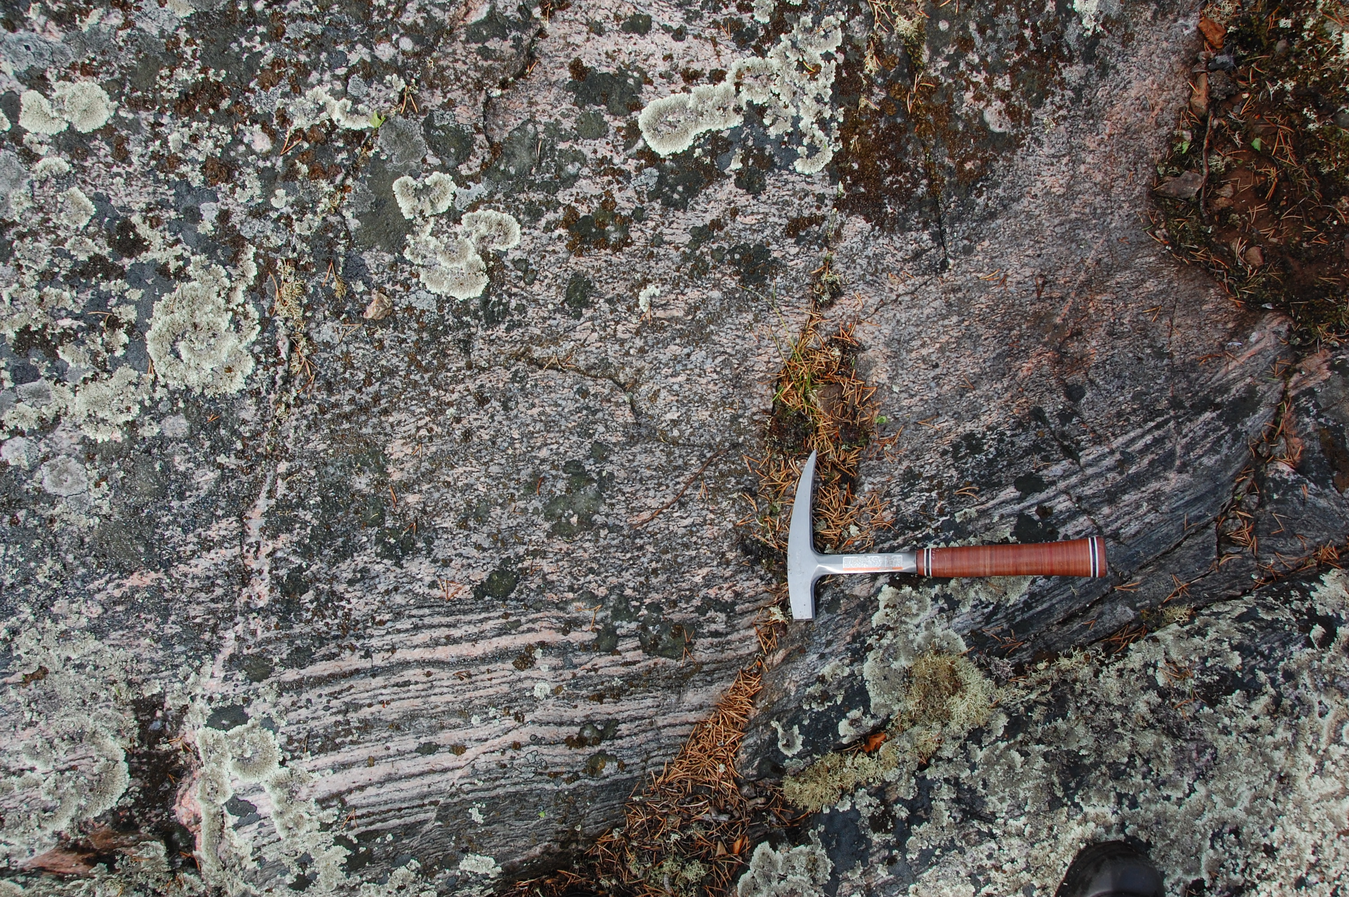
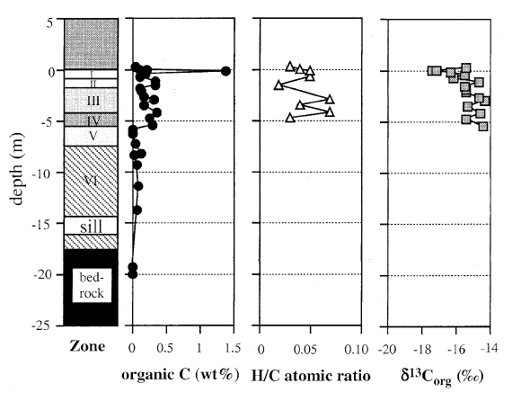
Paleosols: Evidence for Archean BSCs
In the 2.76 Ga Mount Roe paleosol in Western Australia, δ¹³C_{org} values as low as -51‰ suggest that methanotrophic bacteria once inhabited these soils. Their presence would seemingly indicate that some cyanobacterially-produced O₂ was locally available as these microbes either directly utilize O₂ or they utilize substrates (e.g., nitrate, sulfate) that themselves required an oxidative process (Rye and Holland, 2000, Geology):
NH₃ + O₂ → NO₃⁻ or H₂S + O₂ → SO₄²⁻
In the 2.6 Ga Schagen paleosols in South Africa, a high organic C content (up to 1.4 wt.%), the retention of Fe, and an increasing ratio of Fe(III)/Fe(II) with depth all suggest that the ancient soils contained cyanobacteria, and that oxygen concentrations, at least locally, were >0.1% PAL (Watanabe et al., 2000, Nature).

Slide 9
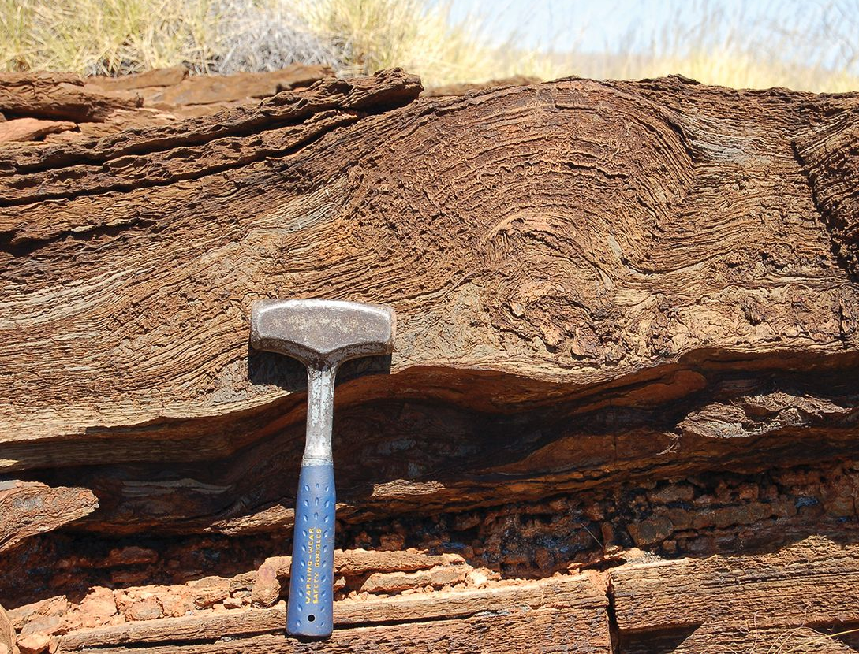
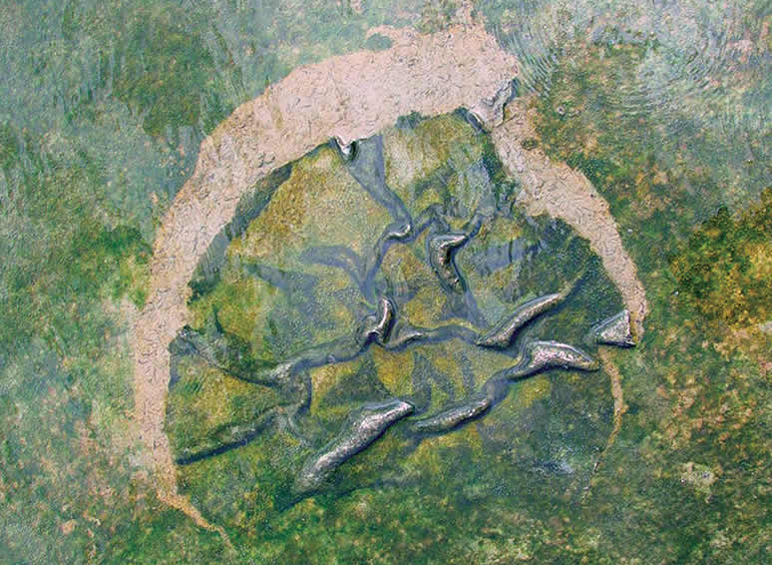
Microbialites: Evidence for Archean FMMs
Stromatolites in lacustrine sediments of the 2.72 Ga Tumbiana Formation in Western Australia are characterized by δ¹³C_{org} values as low as -60‰ PDB, yet a narrow range in δ³⁴S_{py} (Thomazo et al., 2009, EPSL), a combination indicative of aerobic rather than anaerobic methanotrophy. The morphogenetic sequence of mm-scale clumps, reticulate ridge and laminated cones, further indicate the presence of O₂-generating cyanobacteria (Buick, 1992, Science).
The presence of microbially induced sedimentary structures (MISS) in the Archean also supports the notion that FMMs which likely hosted cyanobacteria were widespread within Archean alluvial, lacustrine and shallow marine environments. An unambiguous MISS record in marine settings extends as far back as ca. 3.2 Ga (e.g., Heubeck, 2009, Geology).
Photos of Archean mats

Slide 10
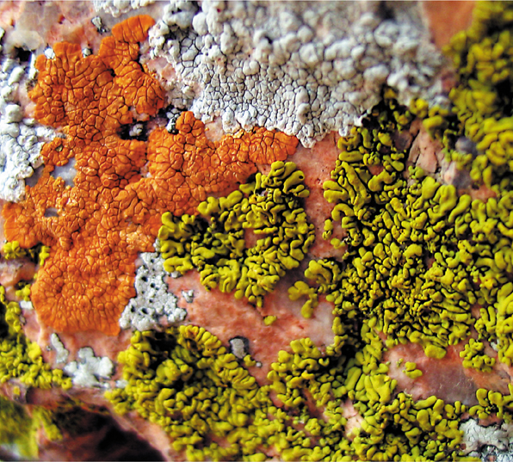
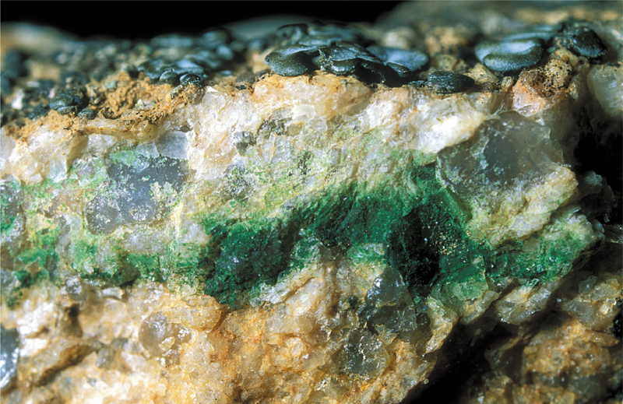
Even Today, O₂ Production is Highly Localized
The high degree of compartmentalization and isolation in BSCs and FMMs from surface conditions means that the weathering reactions that take place at the underlying rock surfaces, or within the mineral-bearing soil and sediment horizons, are out of equilibrium with the atmosphere.

Slide 11
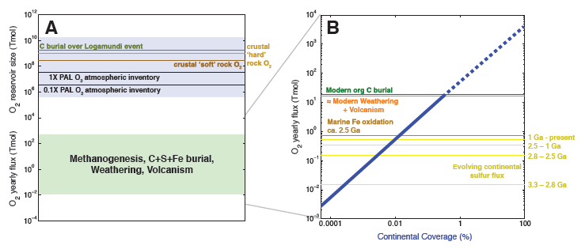
The Disconnect Between Localized O₂ Production/Consumption and Atmospheric Oxygenation
There is a crucial distinction between the quantities of oxygen tied up in major surface reservoirs, for example, the current atmospheric O₂ inventory or the oxidizing equivalents currently contained in the upper continental crust, with the quantities of oxygen implicated in modern fluxes such as oxidative weathering, burial of reduced C, S, and Fe, and volcanic degassing (e.g., Claire et al., 2006, Geobiology). From Figure A, it is clear how sustained imbalances in the latter can drive the former over timescales of 10⁵-10⁸ years.

Slide 12
Minimal Benthic Photosynthesis is Needed to Generate Pre-GOE Oxidative Weathering Signals!
We reconstruct evolving continental SO₄ fluxes (Stueken et al. 2013, Nature Geoscience) to evaluate the extent to which benthic oxygenic photosynthesis could supply the necessary oxidative power to account for those fluxes. Using a mean benthic net O₂ production rate (0.225 nmol cm⁻² s⁻¹), we calculate the potential generation of oxidative equivalents by oxygenic photosynthesis for the modern continental surface area, as a function of surface coverage (Figure B, blue line). We calculate that the modern continental oxidative weathering and volcanic O₂ sink (orange line) is balanced by benthic oxygenic photosynthesis at 100% modern efficiency and a modern continental surface coverage of only 0.3%.

Slide 13
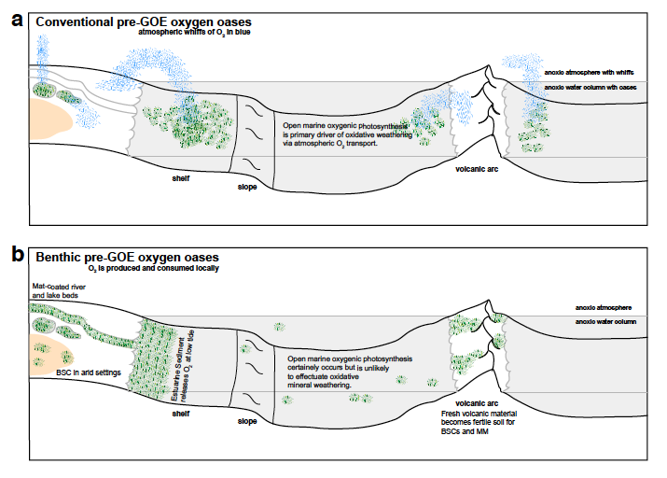
Schematic of (a) conventional pre-GOE oxygen oases occurring primarily in the open marine realm, implying atmospheric transport of O₂ (blue whiffs), versus (b) localized oxygen production and oxidative weathering by benthic oxygenic photosynthesis on the continents prior to the GOE.

Slide 14
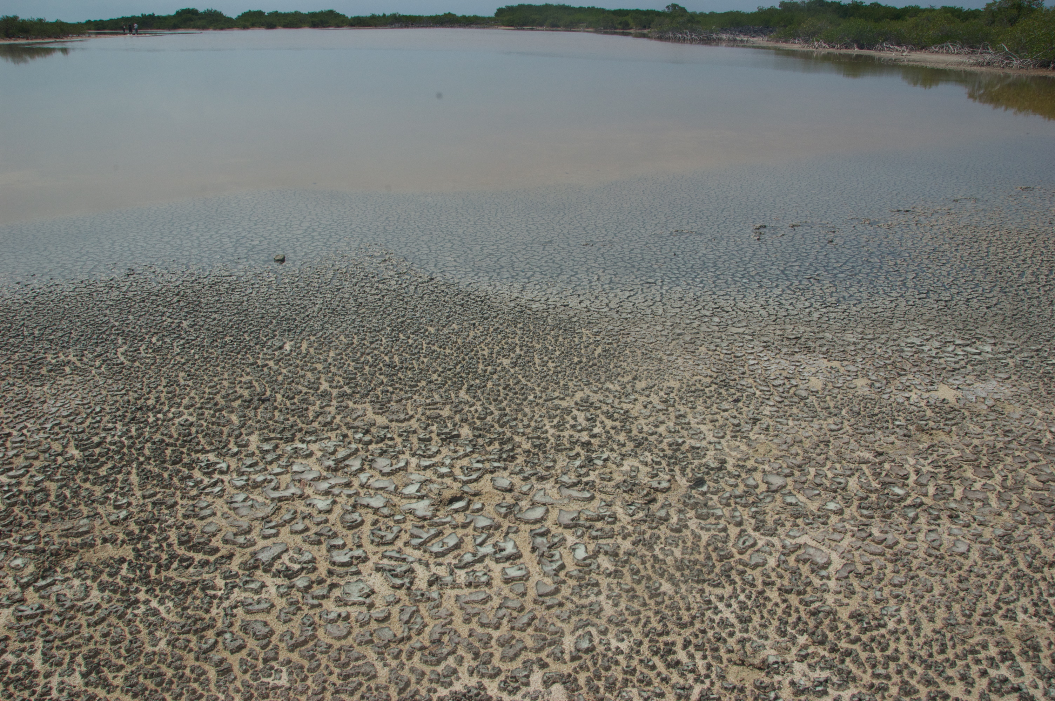
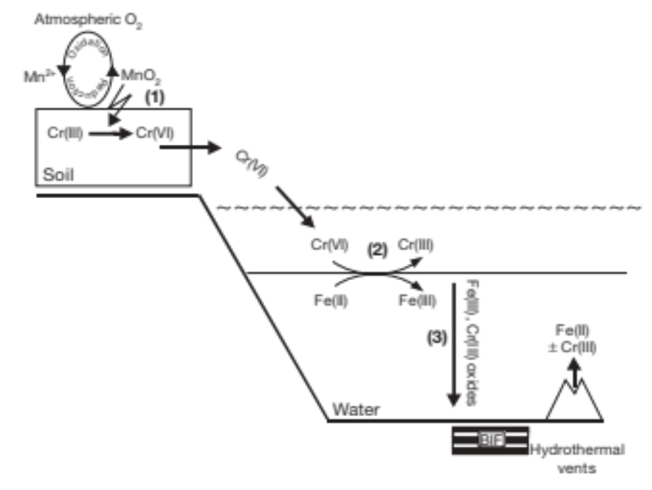
The soluble oxidation products of such reactions (e.g., metal oxyanions) are themselves most likely to be re-reduced in short order, but they may also escape the system and eventually be transported to a marine basin and reduced there instead. Regardless of whether the transport of oxidative weathering products, in either oxidized or re-reduced form, occurs over only millimetres or over catchment scales to marine basins, the elemental or isotopic fractionation signals testifying to their oxidative history are generated.
CrO₄²⁻
FeCr₂O₄
Frei et al. (2009), Nature

Slide 15
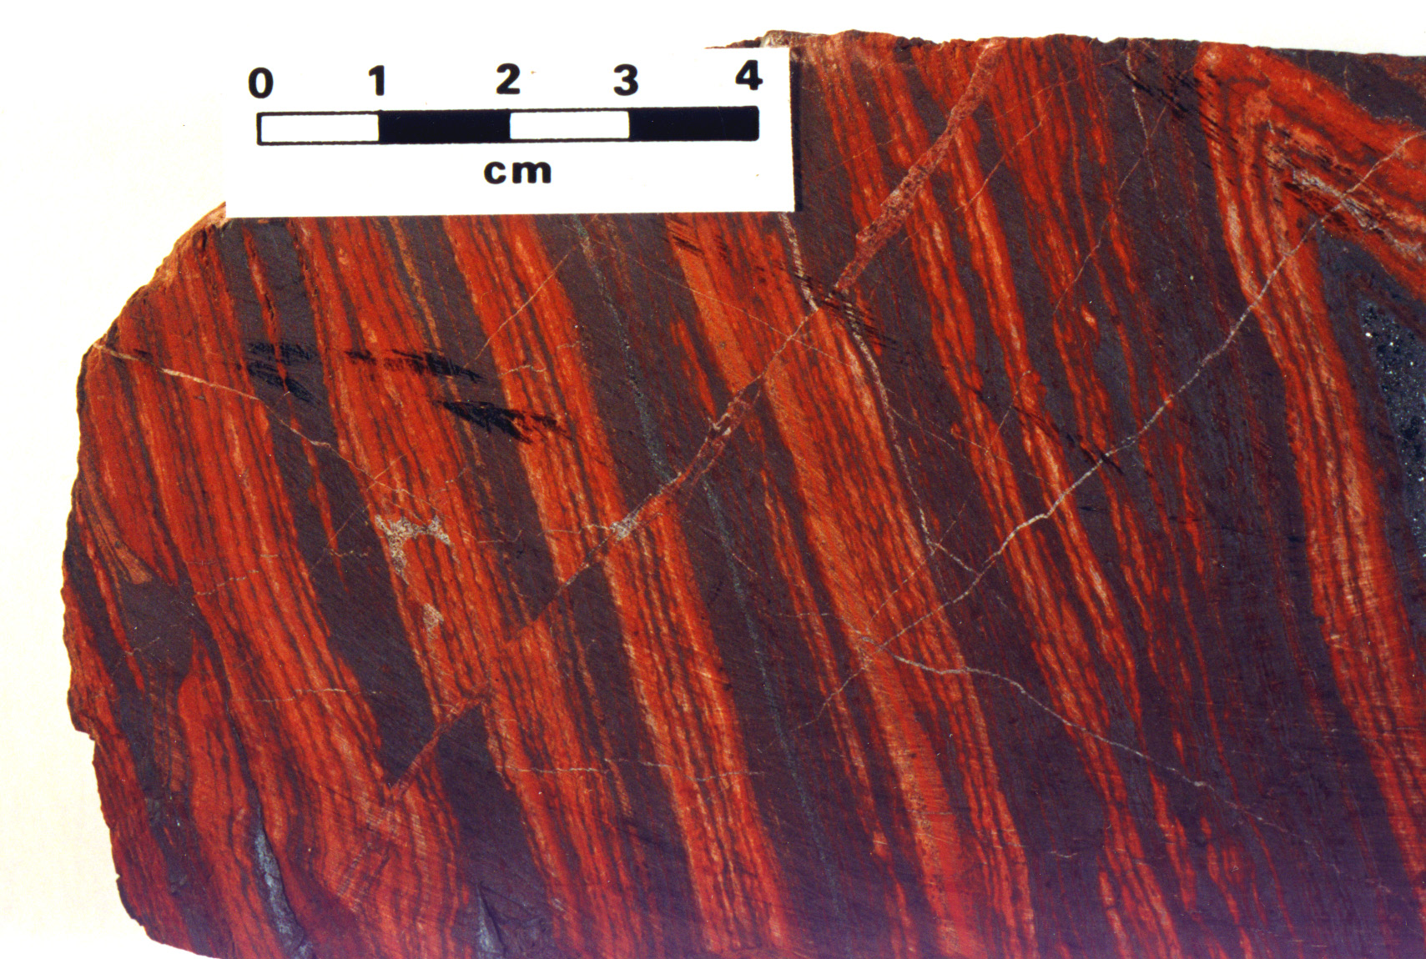
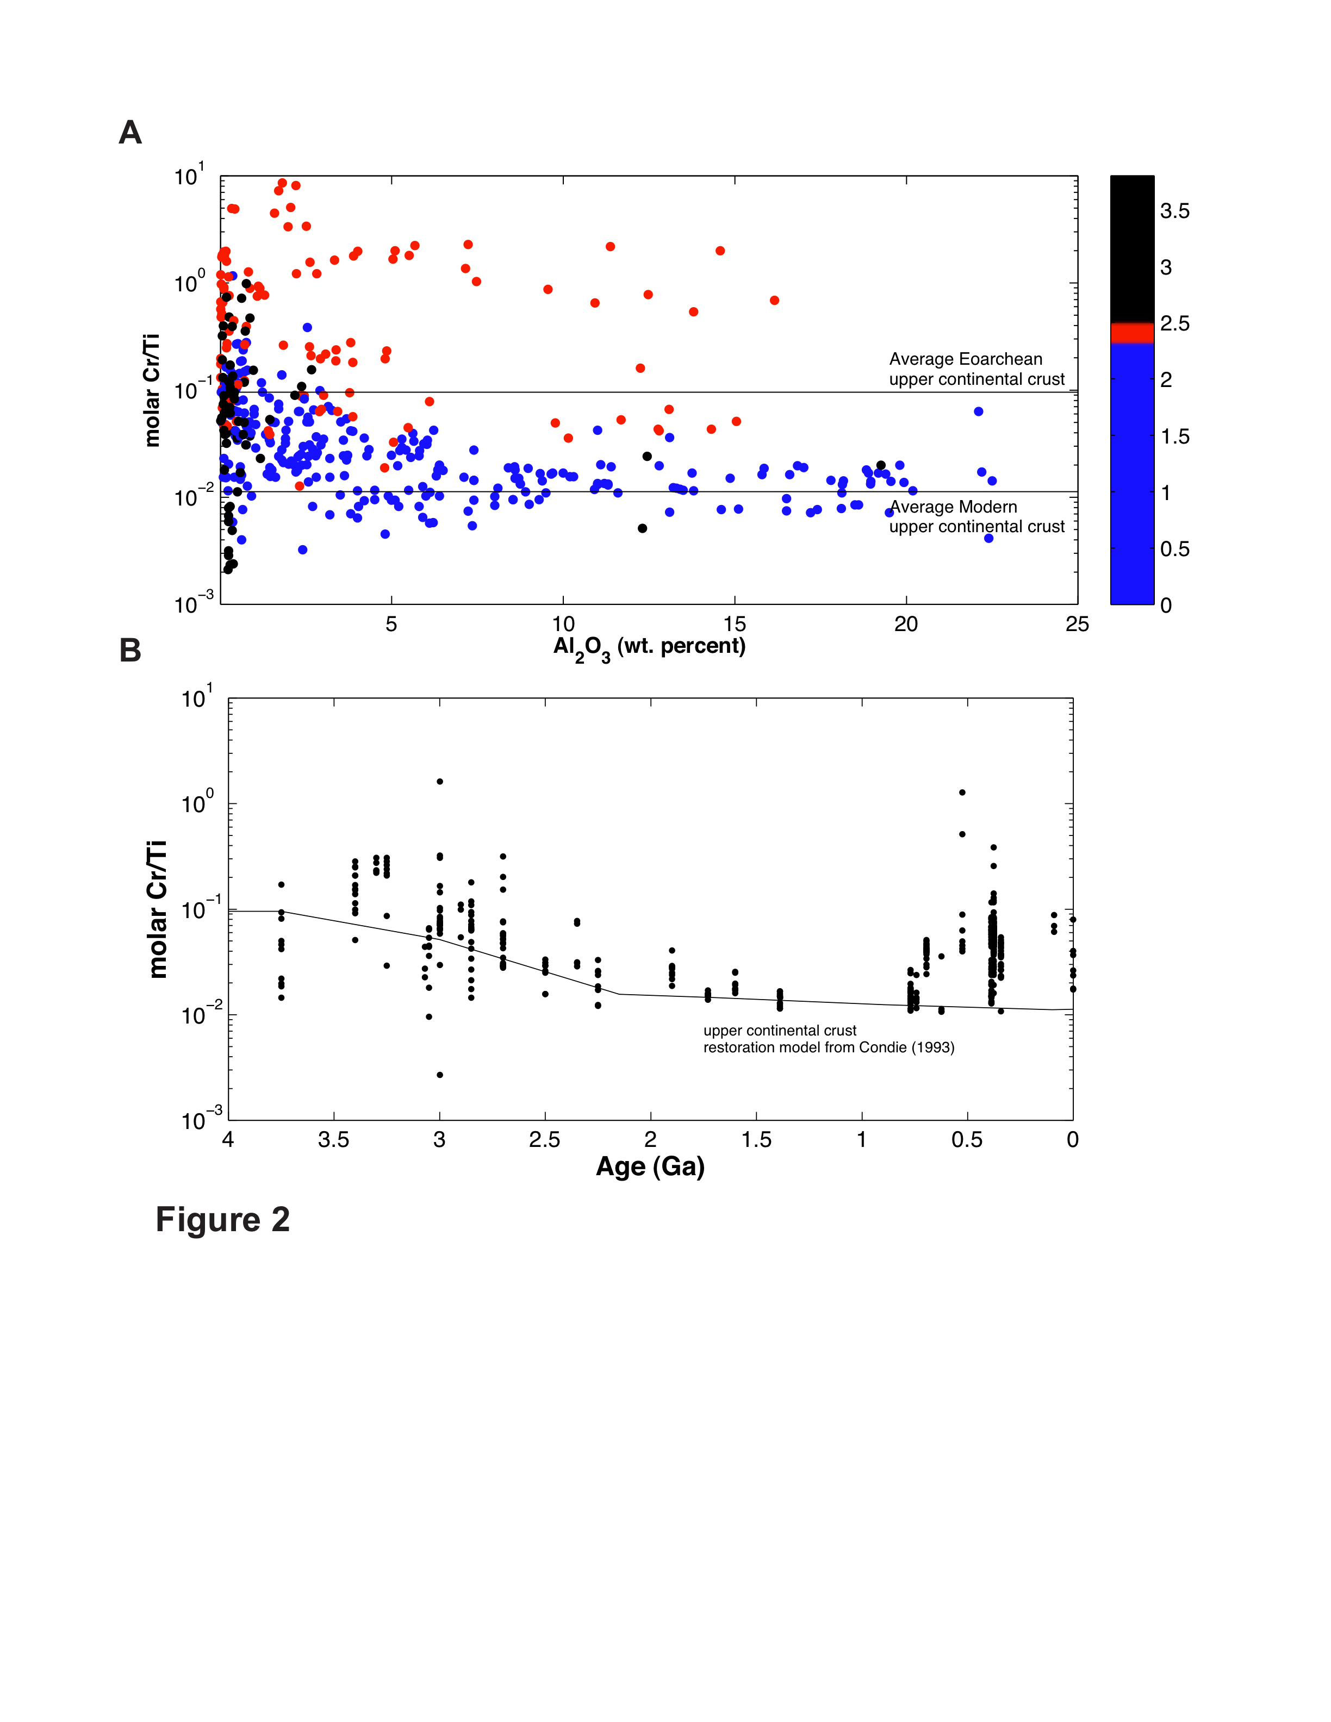
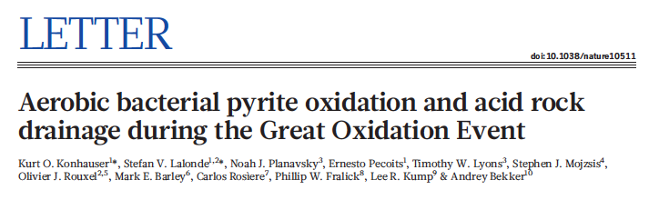
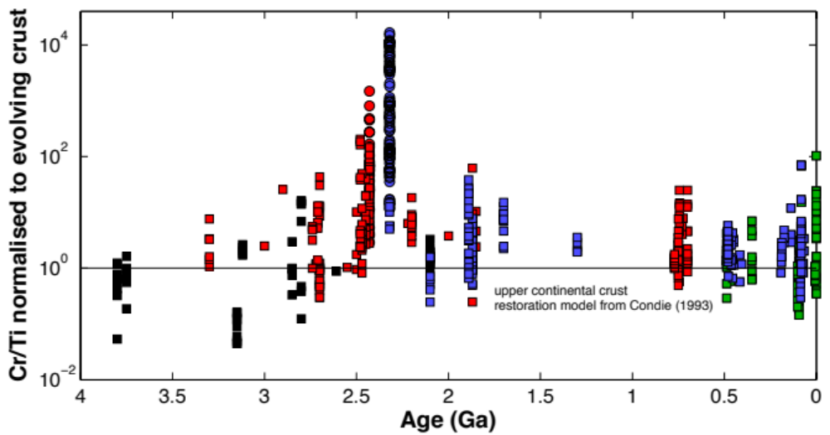
Trends in BIF Cr Content
Caue \ Weeli Wolli
Timeball Hill
Penge \ Kuruman

Slide 16
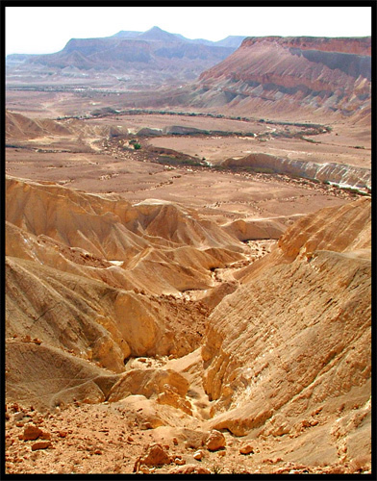
Reconciling Our Model With Trends in BIF Cr Content
In the Archean, aerobic chemolithoautotrophs that oxidized pyrite would have grown within BSCs that were also populated by cyanobacteria. The acid the pyrite oxidizers produced, however, would have been neutralized by the cyanobacterial alkalinity. Therefore, if any Cr(III) was solubilized, it would have instantly re-precipitated as (Fe,Cr)(OH)₃ in the underlying soil. By contrast, Mo and SO₄²⁻ are soluble at circumneutral pH and would have reached the oceans to become incorporated into marine sediments. By 2.5 Ga, however, there was atmospheric O₂ so the aerobes could grow on the surface of exposed pyrite grains and not in direct proximity to the O₂-producing cyanobacteria.

Slide 17
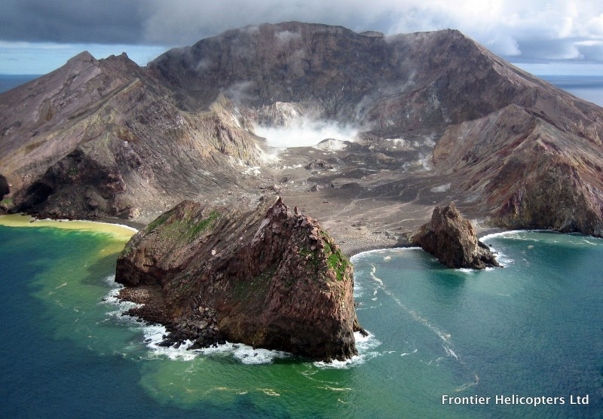
Implications
If we accept that cyanobacteria evolved before 3.0 Ga, then the time lag between O₂ generation and O₂ accumulation in the atmosphere (i.e., the GOE) can be ascribed to two processes:
the cyanobacteria in the Archean were nutrient starved and thus never produced enough O₂ (e.g., P, Mo limitation), or
that there were so many reductants available, that it simply took hundreds of millions of years to accumulate atmospheric O₂.
We add a 3rd possibility, that the influence on global oxygenation by terrestrial cyanobacteria may have been limited by exposed continental surface area.

