Slide 1
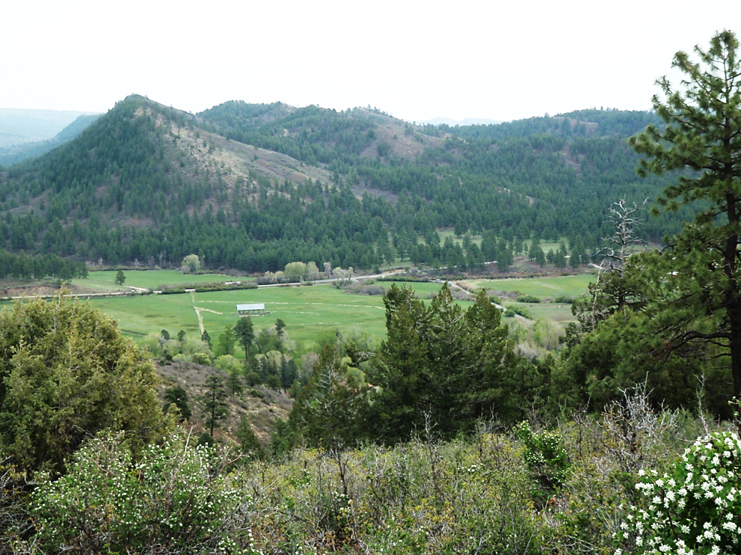
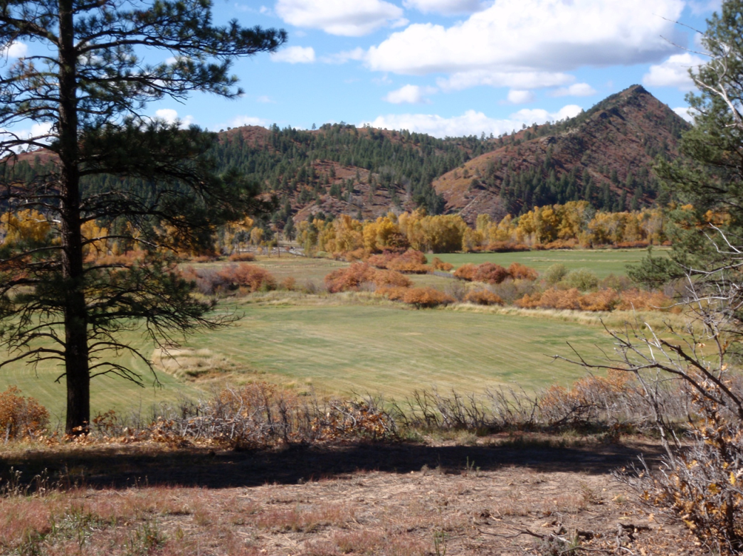
20 YEARS OF CBM PRODUCTION AND MONITORING THE PINE RIVER SUBCROP.
NO DEPLETION
GSA
Presented by: Mr. Paul Oldaker
Graphic Arts by: Mr. Chris Chavez
2014 October 19 • Vancouver, BC, CA

Slide 2
109°
108°
107°
Pine River Gas Seep
UT
CO
Durango
Pagosa Springs
37°
AZ
NM
Kkf
Farmington
Kkf
0
Cuba
36°
50 Km
30 Mi
1971 USGS FASSETT AND HINDS, 2000 RMAG, OLDAKER
Notes:
Four Corners Area
San Juan Basin is third largest gas basin in the USA. Most of the formations produce oil, gas and/or water. Over 30 trillion CF produced so far from 1950..
Fruitland Formation is the most prolific coal bed methane formation in the world. Estimated 50 trillion CF originally in place.

Slide 3
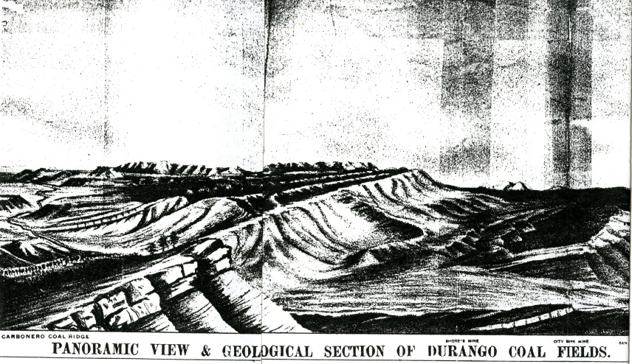
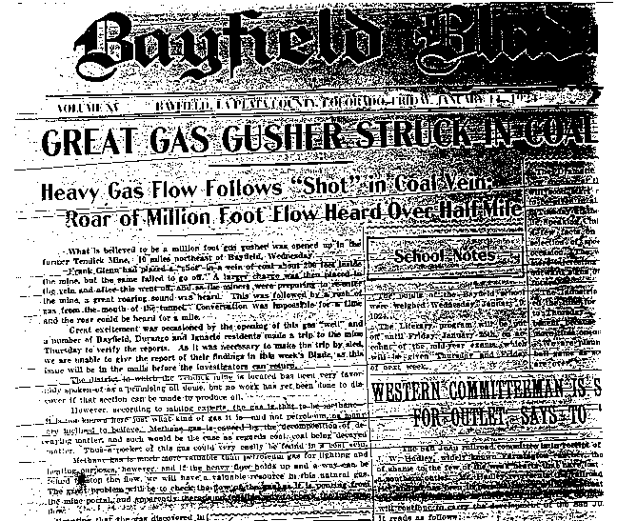
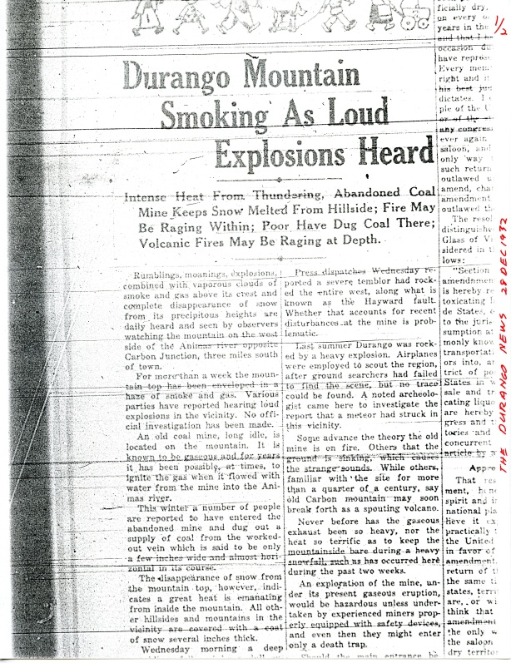
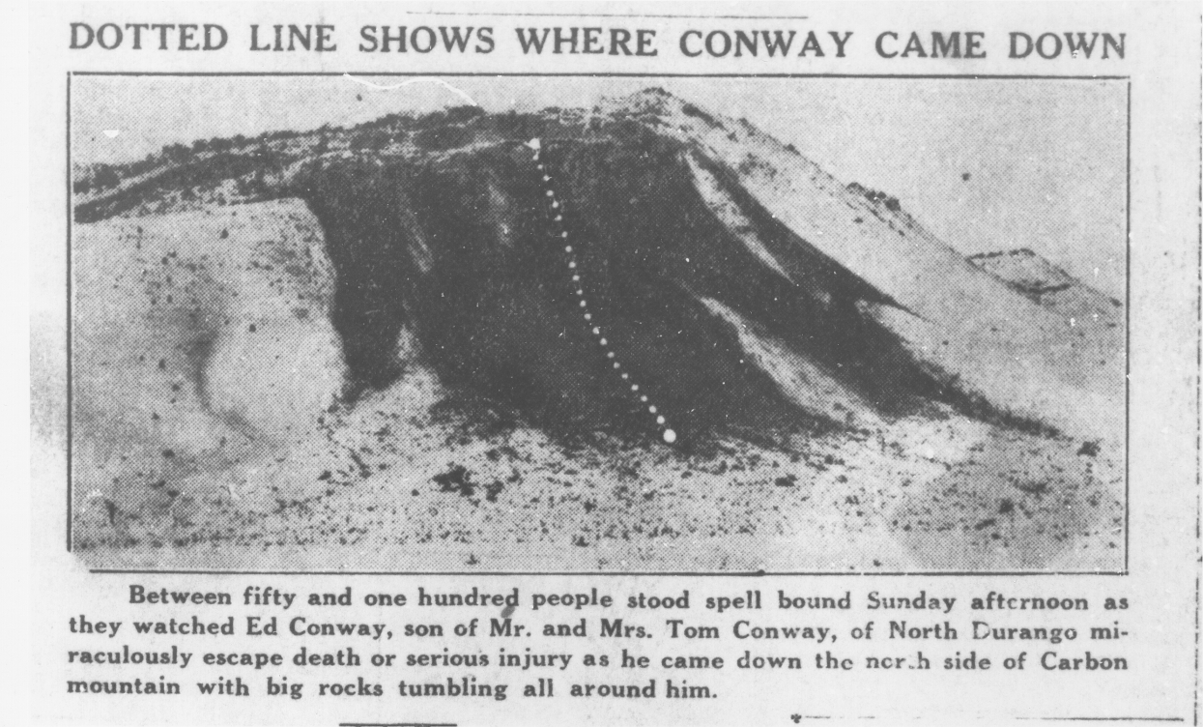
1888
1924
1932-33
1889 CSM Lakes, 1924 Bayfield Blade, 1932 Durango Herald
Notes:
Long history of gas seepage from the Fruitland Formation.
1888- Animas Seep indentified
1924- Tendick Mine blowout like an out of control gas well.
1932 and 1933- Moving Mountain. A coal fire intersects a gas seep and causes explosions and landslides for 9 months.

Slide 4
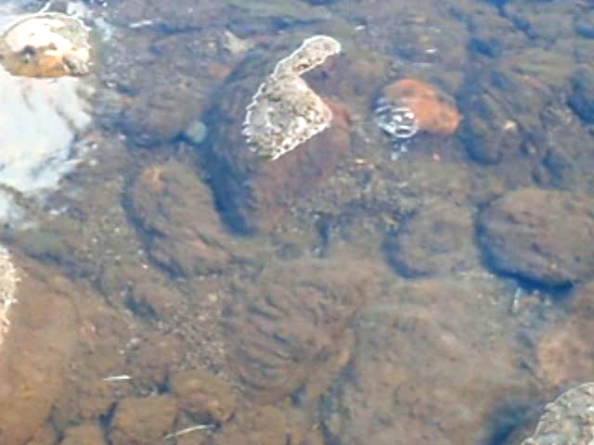
2011 October, Bayfield, Colorado, USA, Authors Collection
Notes:
1993- The Pine River began bubbling. Some accounts of this happening before.

Slide 5

Kk
Kl
Kf
Kpc
PINE RIVER ALLUVIUM
2010 October, Bayfield, Colorado, USA, Authors Collection
Notes:
Pine River alluvium- unconsolidated recently deposited sediments.
Lewis Shale (Kl)- marine mud with a transitional contact with…
Picture Cliffs Sandstone (Kpc)- marine beach sand with a distinct contact with…
Fruitland Formation (Kf)- fresh water swamps that formed thick and thin coal seams. A transitional contact with…
Kirtland Shale (Kk)- shale with thin coals.
All produce natural gas, oil and/or water in the SJB. Downhole video show gas in Kk,f,pc formations. CBM 50 trillion CF in Kf.

Slide 6
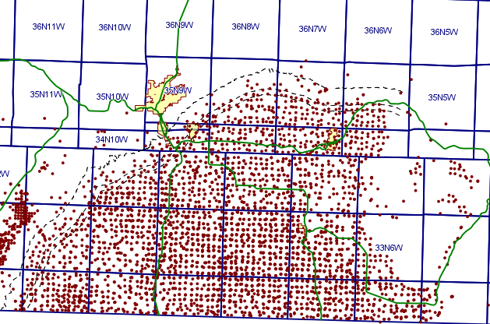
PINE R. SEEPS
2013 September 27 COGCC GIS System
Notes:
50 Trillion CF gets a lot of interest.
About 2,000 Fruitland wells in the Colorado portion.

Slide 7

Kk
Kl
Kf
Kpc
CBM NULL HYPOTHESIS
2010 October, Bayfield, Colorado, USA, Authors Collection
Notes:
Led to the null hypothesis that the water pumping in the Fruitland for CBM caused water levels/pressures in the Fruitland were reduced and caused gas to be released at the subcrop.
Depends on the entire Fruitland being hydraulically connected.
Does not explain historical seepage.
Downward water flow and ascending gas flow at the same time is a problem.
Test by several methods.

Slide 8
CBM, WATER, AND
SEEP PRODUCTION

Slide 9
PRODUCTION CURVES AND GAS FLOW,
7,000,000
PINE RIVER RANCHES
0.25
Water 3 mile
Gas 3 mile
Pyramid Flow
6,000,000
1
P
2
R
1
R
0.20
O
4
4
O
5,000,000
F
S
F
Annual Gas Production in MCF
E
5
O
O
1
E
F
F
3
9
P
O
F
2
3
3
0.15
4,000,000
3
2
2
W
S
8
2
E
E
2
W
O
O
O
L
P
4
W
W
E
Pyramid Gas Flow, CFD
F
F
F
L
E
E
L
3,000,000
S
9
W
L
L
L
3
5
7
3
E
L
L
S
0.10
W
9
L
S
S
W
W
0
L
0
E
E
E
S
0
0
6
2,000,000
L
L
L
4
5
Annual Water Production in bbl
L
L
0
L
S
S
S
1
0.05
1,000,000
8
8
8
7
8
9
29,719,208 bbl
9,244,858 bbl
0
0.00
87
88
89
90
91
92
93
94
95
96
97
98
99
00
01
02
03
04
05
06
07
08
09
10
11
12
13
2014 April 26, Pine River Ranches Monitoring Report by Paul Oldaker
Notes:
Within 3 miles of seeps 19 CBM wells were drilled and produced.
14 infill wells were then drilled.
Water production increases after new wells produced.
Gas production increases after new wells produced.
Seep production began 3 years after the first 19 wells were drilled. Then dropped before, during and after the infill wells were drilled. The seep production is acting differently than the CBM reservoir.
9 million bbl to start the seeps, but almost 30 million bbl produced to date.

Slide 10
DOWNHOLE VIDEOS,
VERTICAL PRESSURES
BY PACKER TESTING

Slide 11
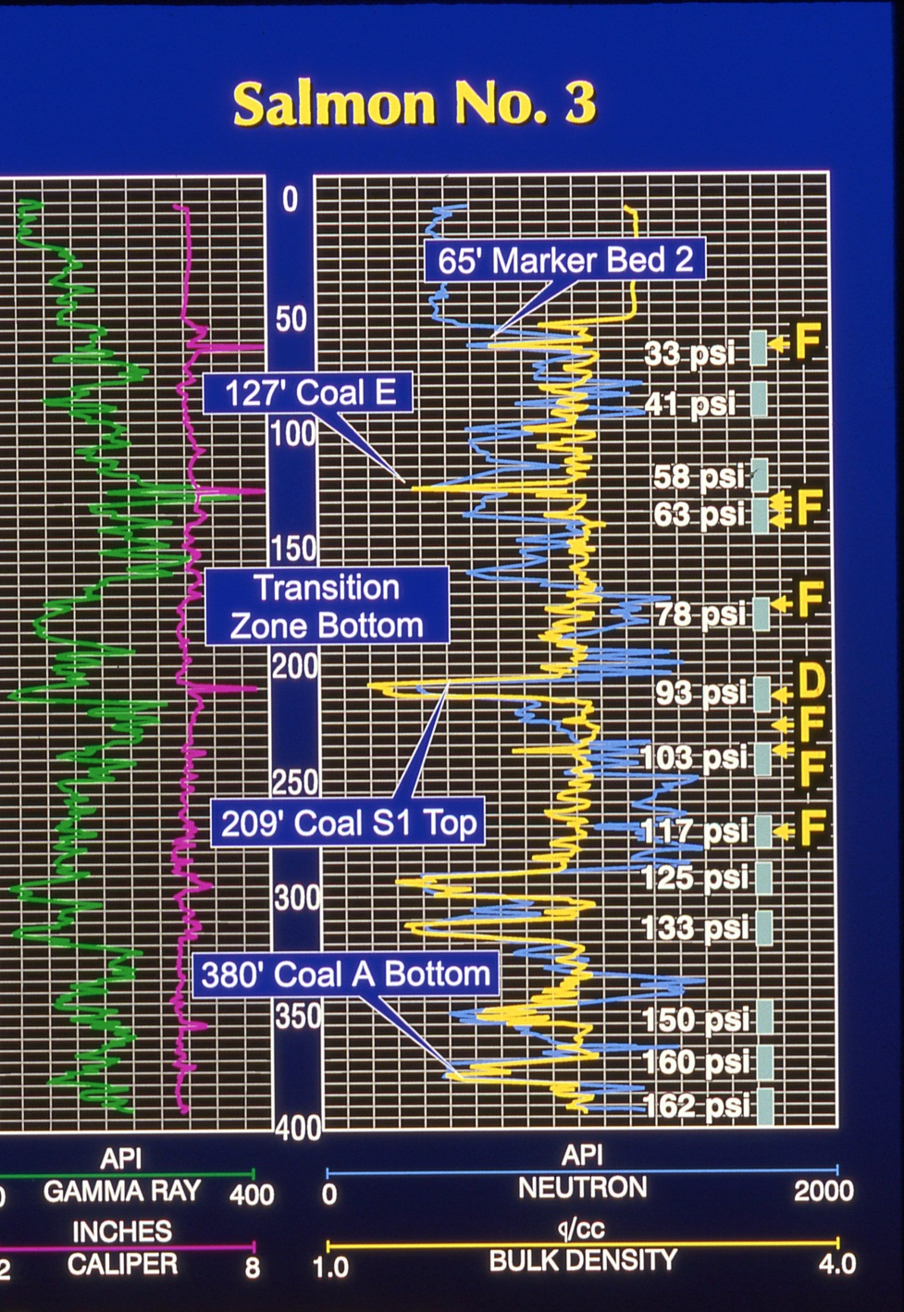
1995 November, Bayfield, Colorado, USA, Authors Collection
Notes:
5 coals in the Fruitland nearest the seeps.
2 thin coals in the transition zone with the Kirtland.
Downhole video showed no gas in the lowest 4 coal seams. This is a real problem for the null hypothesis.
Desorbing gas in uppermost Fruitland coal seam. Location matches a secondary seep.
Six conventional gas zones in siltstones and sandstones in the Fruitland and transition zone. One matches primary seep. Another problem for the null hypothesis.
All were packer tested for pressures.

Slide 12
SALMON 2 PACKER TESTS, PINE RIVER RANCHES
-180
Test Zone
Hydrostatic
OVERPRESSURE
-200
-
Test 1=149 psi
215 ft=
-220
Video of
Test 2=122 psi
Siltstone Gas
Depth, ft
-240
Test 3=108 psi
Test 4=113 psi
-260
UNDERPRESSURE
Test 5=118 psi
Test 6=122 psi
-280
-
288 ft=Top of Fruitland
Test 7=128 psi
-
-300
299 ft=Video of Displacement Gas
80
90
100
110
120
130
140
150
Pressure, psig
2014 April 26, Pine River Ranches Monitoring Report by Paul Oldaker
Notes:
Define normal, over and under pressure.
Video show gas in transition zone which matches a large overpressure area.
No under pressure due to CBM production. Bad for the null hypothesis.

Slide 13
TEMPERATURE TRACER,
GEOTHERMAL GRADIENT

Slide 14
GEOTHERMAL GRADIENT, PINE RIVER RANCHES
-10
-30
Depth, ft
COLD PINE RIVER
-50
COLD PINE RIVER
ALLUVIAL
WATER
ALLUVIAL
WATER
FLOWING DOWN INTO
FLOWING DOWN INTO
-70
WARMER BEDROCK
WARMER BEDROCK
-90
Qal, James 2, 17 Year Mean
Fruitland Bedrock, 20 Year Mean
Geothermal Line
Qal, Pick Bar, 20 Year Mean
-110
8
9
10
11
12
13
14
Transducer Temperature, C
2014 April 26, Pine River Ranches Monitoring Report by Paul Oldaker
Notes:
Normal geothermal gradient outside the seep.
If colder water at depth then alluvial water is going down into the Fruitland.
If hotter water at surface then warmer Fruitland water is going up into the alluvium.
The winner is warmer water going up. Strong measurements that the stream is not being depleted. Bad for the null hypothesis.

Slide 15
CATION WATER QUALITY

Slide 16
2000 SODIUM % COMPARISON, PINE RIVER RANCHES
100
90
80
70
60
Sodium %
50
40
30
20
10
0
2014 April 26, Pine River Ranches Monitoring Report by Paul Oldaker
Notes:
Bedrock wells are high in sodium.
Alluvium and river are low in sodium.
No bedrock wells with low sodium. No flow from alluvium to bedrock.
One alluvial well with high sodium. Flow was from bedrock to alluvium.

Slide 17
WATER AGE

Slide 18
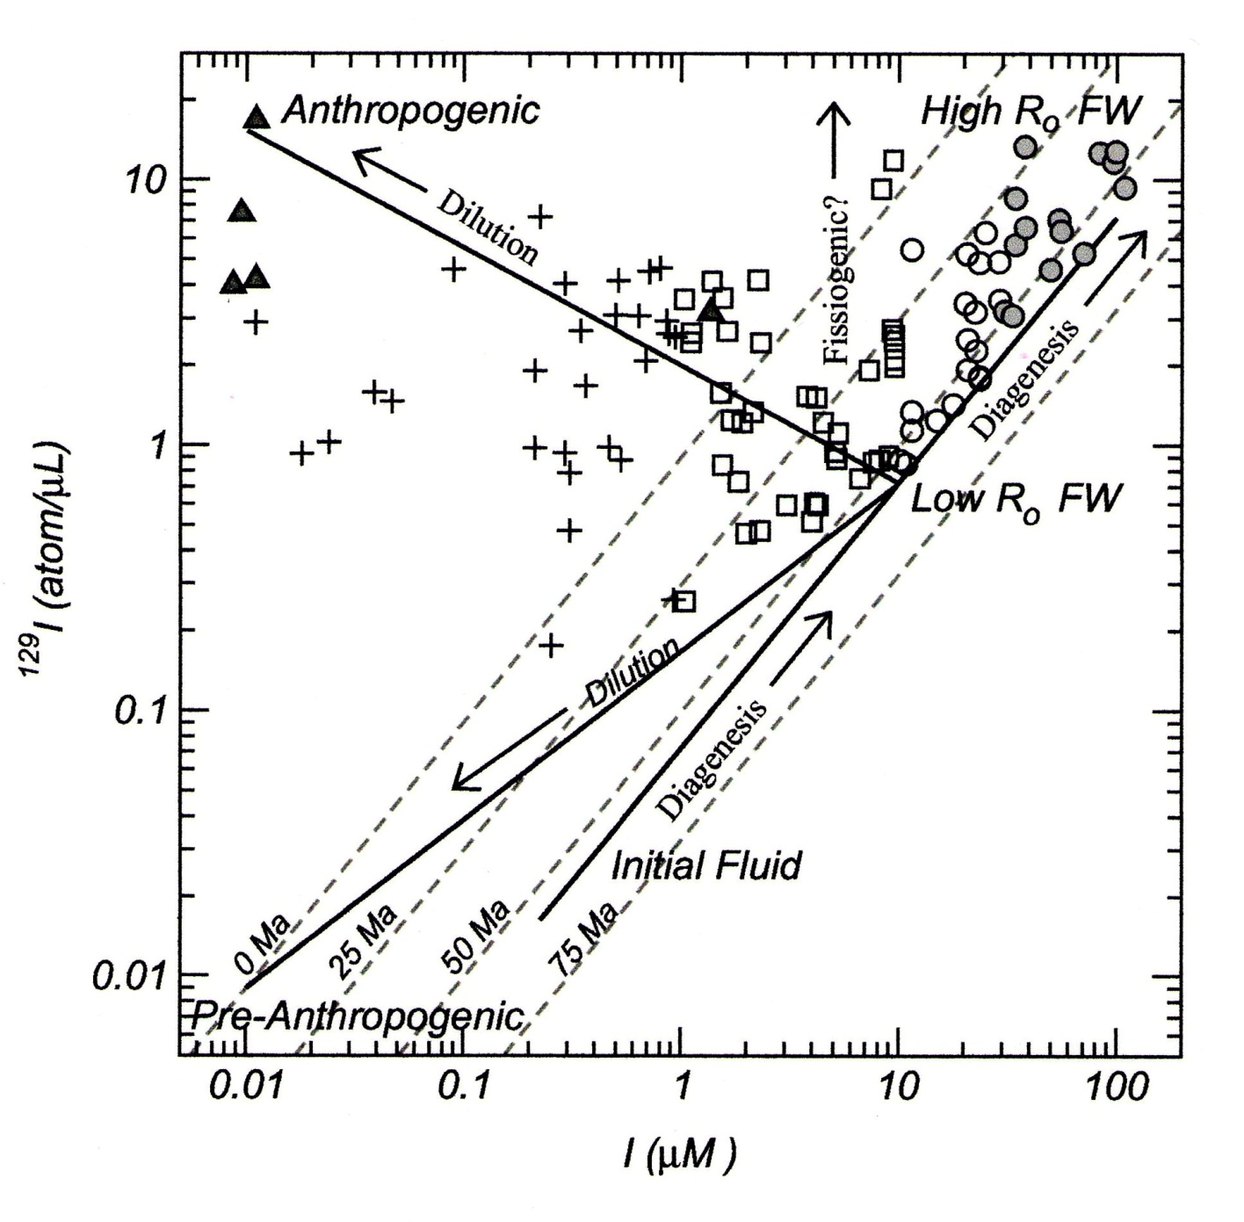
2003 Snyder et al. Figure 16
Notes:
Snyder et al. 2003 (Rice University) used iodine 129 to age very old Fruitland waters.

Slide 19
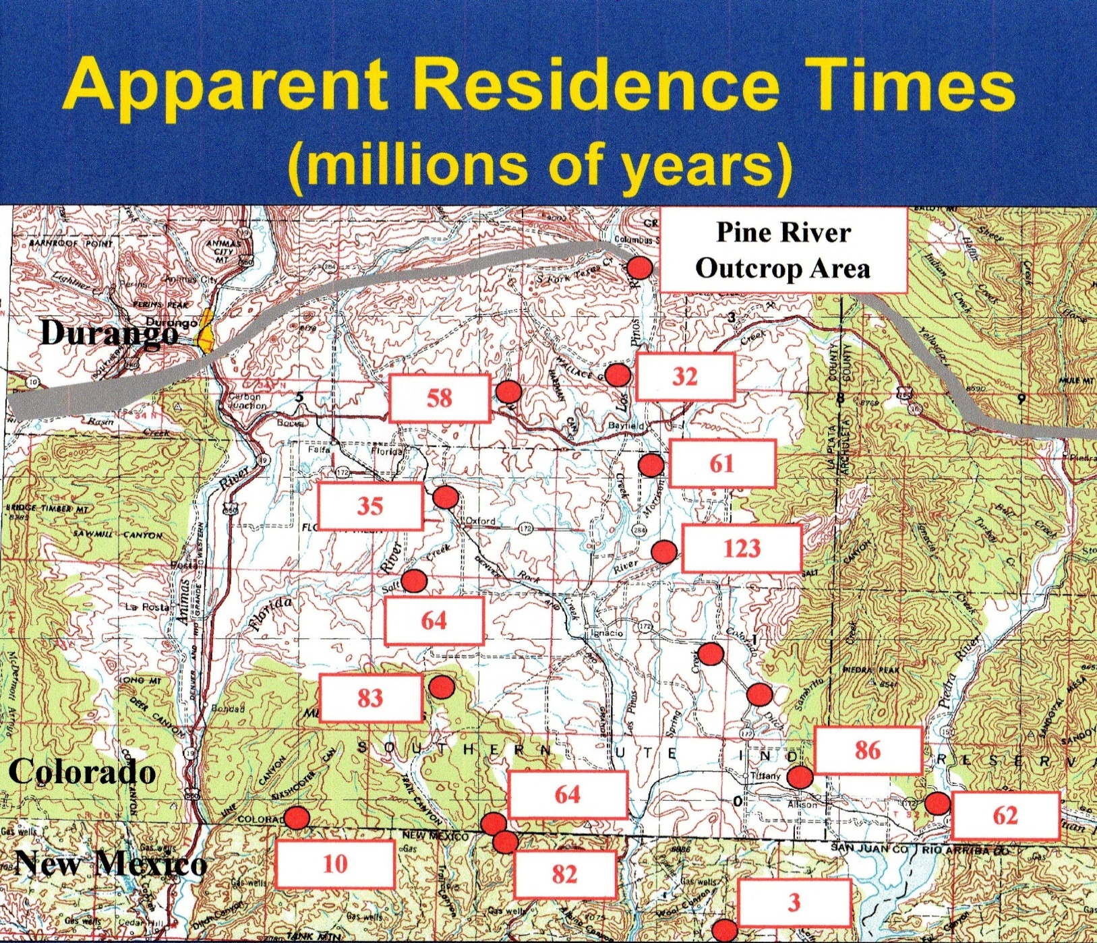
2003 Sanford and Sorek
Notes:
Sandford and Sorek (CSU) used helium 4 to age very old Fruitland waters,

Slide 20
Data from Snyder et al 2003
Notes:
Snyder et al. also took chlorine 36 a true radioisotop. The youngest water was a well about 1.5 mile from the Pine River seeps. The result was half million year old water. Indicates a very closed system.

Slide 21
AREAL POTENTIOMETRIC
HEAD TRENDS

Slide 22
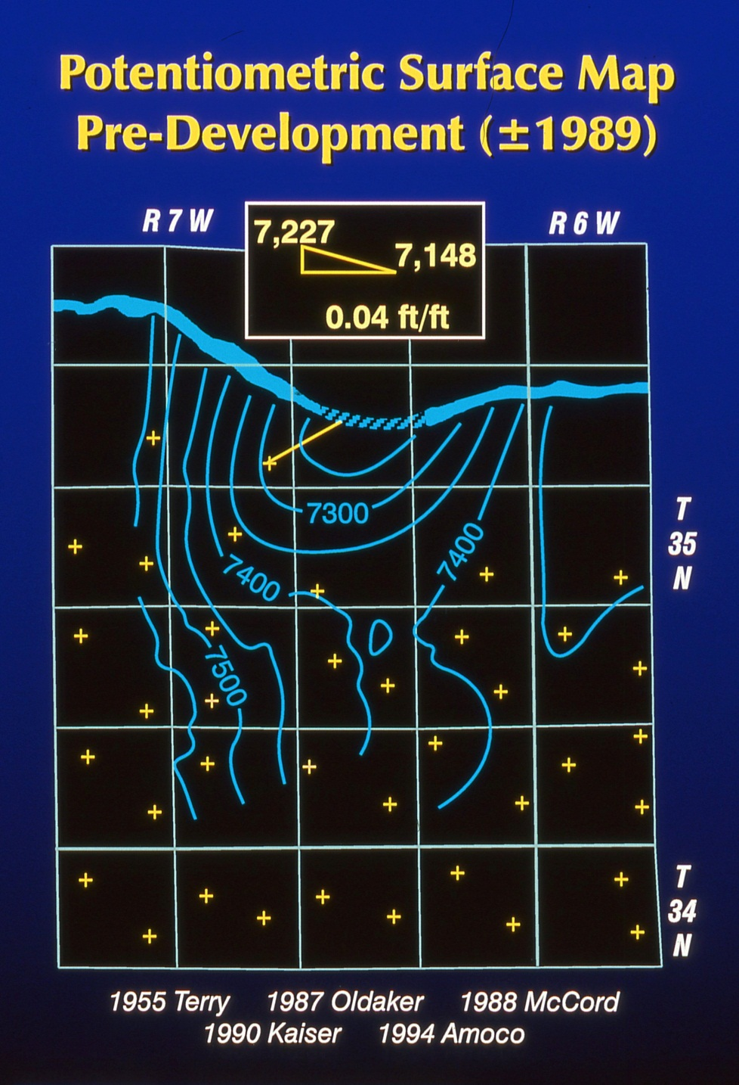
1955-1994, Bayfield, Colorado, USA, Authors Collection
Notes:
Pre development potentiometric surface.
CBM wells.
Downbasin monitor wells.
Subcrop monitor wells.
All should decline if all connected.

Slide 23
FRUITLAND POTENTIOMETRIC HEAD
PINE RIVER RANCHES
7,190
GURR
7,170
KILLIAN SHALLOW
JAMES 1
7,150
+
+
+
+
+
+
+
+
+
+
+
+
+
+
+
+
+
+
+
+
+
+
+
+
+
+
+
+
+
+
7,130
KILLIAN DEEP
5 OF 24 WELLS 2001
4 OF 28 WELLS 2004
4 OF 32 WELLS 2005
1 OF 33 WELLS 2006
SALMON 3
7,110
SALMON 3
GURR
7,090
POLE BARN
7,070
Potentiometric Head, ft amsl
7,050
7,030
7,010
6,990
6,970
6,950
6,930
+
+
1994
1995
1996
1997
1998
1999
2000
2001
2002
2003
2004
2005
2006
2007
2008
2009
2010
2011
2012
2013
2014 April 26, Pine River Ranches Monitoring Report by Paul Oldaker
Notes:
Nearest downbasin monitor wells declined, but 2-3 years after seep.
Subcrop monitor wells did not decline and show seasonality.
Neither sets of monitor wells reacted to the infill wells.
There is a hydraulic boundary between the CBM production and the suncrop.

Slide 24
CBM NULL HYPOTHESIS
DOES NOT EXPLAIN HISTORICAL SEEPAGE,
SEEP PRODUCTION DIFFERENT THAN CBM,
SEEP PRODUCTION DOES NOT REACT TO INFILL
VIDEO- SEEP DIFFERENT ZONES THAN CBM,
OVERPRESSURED NOT UNDERPRESSURED,
TEMPERATURE- FLOW FROM BEDROCK TO Qal,
WATER WAS TOO OLD BY AGE ISOTOPES,
BOUNDARY BETWEEN CBM AND SUBCROP,
I REJECT THE NULL CBM HYPOTHESIS,
NO DEPLETION.
2014 April 26, Pine River Ranches Monitoring Report

Slide 25
1999 PRECIPITATION AND PYRAMID GAS FLOW,
PINE RIVER RANCHES
PRECIPITATION
H
0.21
9.0
MONTHLY PRECIPITATION
I
I
GAS FLOW
G
N
H
U
M
8.0
N
E
R
D
T
I
A
E
7.0
V
T
R
E
E
R
S
0.16
Precipitation, in
Pyramid Gas Flow, CFD
6.0
5.0
4.0
17.71 in HIGHEST
0.11
3.0
JUL, AUG, SEP PRECIPITATION
IN 71 YEAR
RECORD
2.0
1.0
0.0
0.06
1999-Jan-01
1999-Apr-02
1999-Jul-02
1999-Oct-01
1999-Dec-31
2014 April 26, PRR Report and USBOR Vallecito Precipitation Record
Notes:
1999- July, August, September precipitation was over 17 inches.
With continued precipitation the gas flow rate went up.
When precipitation ended in October, November and December the gas flow rate went down.
March gas flow peak was due to low altitude snowmelt.
Also a new seep, the Tertiary seep trend was identified.

Slide 26
2002 PRECIPITATION AND PYRAMID GAS FLOW,
PINE RIVER RANCHES
0.21
9.0
PRECIPITATION
MONTHLY PRECIPITATION
GAS FLOW
8.0
7.0
17.23
in THIRD
LOWEST ANNUAL PRECIPITATION IN 71 YEAR RECORD
0.16
6.0
Pyramid Gas Flow, CFD
Precipitation, in
5.0
4.0
3.0
0.11
2.0
1.0
0.0
0.06
2002-Jan-01
2002-Apr-02
2002-Jul-02
2002-Oct-01
2002-Dec-31
2014 April 26, PRR Report and USBOR Vallecito Precipitation Record
Notes:
2002- Same scale as previous graph. Just over 17 inches of precipitation in entire year. A real drought.
Gas flow rate for entire year was much reduced.
Again July, August and September had rain and gas flow rate increased with it.
Another February gas flow peak due to low altitude snowmelt.

Slide 27
Kk
KkKf
Kf
Kpc
Kl
PRECIPITATION HYPOTHESIS- 2000
2010 October, Bayfield, Colorado, USA, Authors Collection
Notes:
In 2000 I formed the precipitation null hypothesis.
An overpressured Transition zone.
As rain continues, water levels in the transition zone rise and push out more gas.

Slide 28
TEST BY SEEP PRODUCTION
AND CUMULATIVE
EXCESS, DEFICIT ANALYSIS

Slide 29
PRECIPITATION ADJUSTED ACCUMULATED EXCESS/DEFICIT, PINE RIVER
40
RANCHES
0.18
DURANGO
VALLECITO
PYRAMID FLOW
35
0.15
30
25
0.12
1
1
20
8
1
9
0.09
Excess/Deficit, inches
8
9
9
15
8
2
1
4
0.06
10
C
1
V
1
A
T
9
A
9
Mean Annual Pyramid Gas Flow, CFD
5
R
E
3
L
9
1
0.03
B
N
2
E
3
9
0
O
D
N
9
0.00
1880
1890
N
1900
1910
1920
1930
1940
1950
1960
1970
1980
1990
2000
2010
I
M
C
P
9
-5
C
O
I
I
-0.03
J
K
V
A
N
T
Precipitation Accumulated
-10
U
I
E
E
N
M
N
C
R
-0.06
-15
C
I
G
A
R
T
T
N
N
I
I
-20
I
E
M
Y
V
A
-0.09
O
O
O
E
R
-25
N
G
U
N
R
Y
-0.12
-30
A
N
S
S
T
S
S
S
-35
E
S
A
E
E
E
-0.15
E
E
I
E
E
E
-40
P
R
N
P
P
P
-0.18
Year
2014 April 26, PRR Report, 1999 CWRRI, Drought in Colorado, NOAA
Notes:
Durango record is longest in area, about 20 miles from site. Vallecito record is closest to site at 6 miles north. Periods of excess and deficit.
Gas seep observations match excess periods. 1930’s, 1940’s, 1950’s, 1960’s, 1970’s have no seep observations even though SJB was crawling with uranium prospectors, Sandstone gas boom, coal mine boom and formation of the Four Corners Geological Society.
Gas Flow matches red Vallecito line.

Slide 30
PRECIPITATION ADJUSTED ACCUMULATED EXCESS/DEFICIT
PINE RIVER RANCHES
40
2
0.18
VALLECITO
PYRAMID FLOW
0
1
S
2
2
0
35
9
E
0
0
9
9
C
0
0
0.15
3
O
4
5
T
30
N
1
O
P
D
9
T
T
I
A
9
E
O
2
V
N
R
9
R
0
E
0.12
25
E
Y
I
T
2
1
G
T
D
I
0
2
R
S
E
E
A
0
I
I
E
R
N
R
7
I
N
Precipitation Accumulated Excess/Deficit, inches
T
T
Y
Mean Annual Pyramid Gas Flow, CFD
20
V
E
N
V
0.09
E
P
I
I
V
T
A
R
A
F
S
E
E
S
I
R
I
E
G
R
I
15
P
D
Y
E
E
M
O
R
E
D
P
I
I
N
0.06
I
N
S
N
T
10
M
T
E
C
V
E
A
I
E
E
A
N
R
F
P
A
S
T
Y
I
S
I
0.03
5
E
E
O
S
&
D
S
N
E
E
0
P
0.00
1992
1993
1994
1995
1996
1997
1998
1999
2000
2001
2002
2003
2004
2005
2006
2007
2008
2009
S
2010
2011
2012
2013
Year
2014 April 26, PRR Report, 1999 CWRRI, Drought in Colorado, NOAA
Notes:
Very similar lines.
Seep observations match.
1993 Primary and secondary seep trends identified.
1999 Tertiary seep trend identified.
2002 Drought year
2004 Tertiary seep ceases.
2005 Vegetation invasion began.
2009 Primary and Secondary seeps go intermittent.

Slide 31
2014 April 26, PRR Report and NOAA Vallecito Precipitation Record
Notes:
Cross plot is direct relation.
About 10 inches of cumulated excess needed to start.
Gas flow rate caps, probably due to low permeability.

Slide 32
PRECIP. NULL HYPOTHESIS-OLDAKER 2000
CUMULATIVE EXCESS PRECIPITATION
EXPLAINS EPISODIC HISTORICAL SEEPS,
CUMULATIVE EXCESS PRECIPITATION
DIRECTLY RELATED TO CURRENT SEEP
PRODUCTION,
I CONTINUE TO ACCEPT THE NULL PRECIPITATION HYPOTHESIS AFTER 13 YEARS AND COUNTING.
2014 April 26, Pine River Ranches Monitoring Report

Slide 33
THANKS TO Bp and PETER FALK
PAUL OLDAKER
HYDROGEOLOGIST
P.O. BOX 27090
FEDERAL WAY, WA
98093
970-846-0082
pauloldaker@netscape.com

