Slide 1

Catastrophic Floods of Basalt: Lessons from Mars
Laszlo Keszthelyi, Colin Dundas, Windy Jaeger, Alfred McEwen
USGS Astrogeology Science Center
University of Arizona, Lunar and Planetary Laboratory

Slide 2

Key Points
Individual flood basalt eruptions on Earth cannot be vigorous enough to cause mass extinctions.
  We need to seek the unusually catastrophic event within the formation of the flood basalt province
Catastrophic floods of basalt on Mars are vigorous enough.
  What are the diagnostic criteria to search for a “catastrophic” flood lava on Earth?

Slide 3
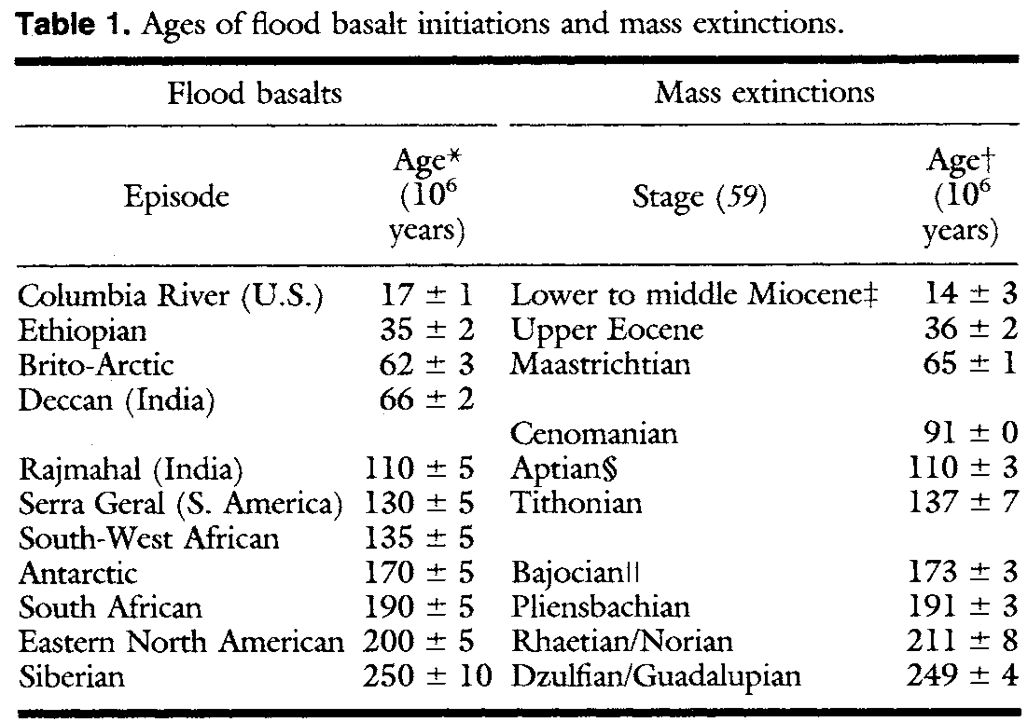

Surely more than a coincidence?
HiRISE
MARCI
CTX
MCS
CRISM
Rampino and Stothers (1988)

Slide 4
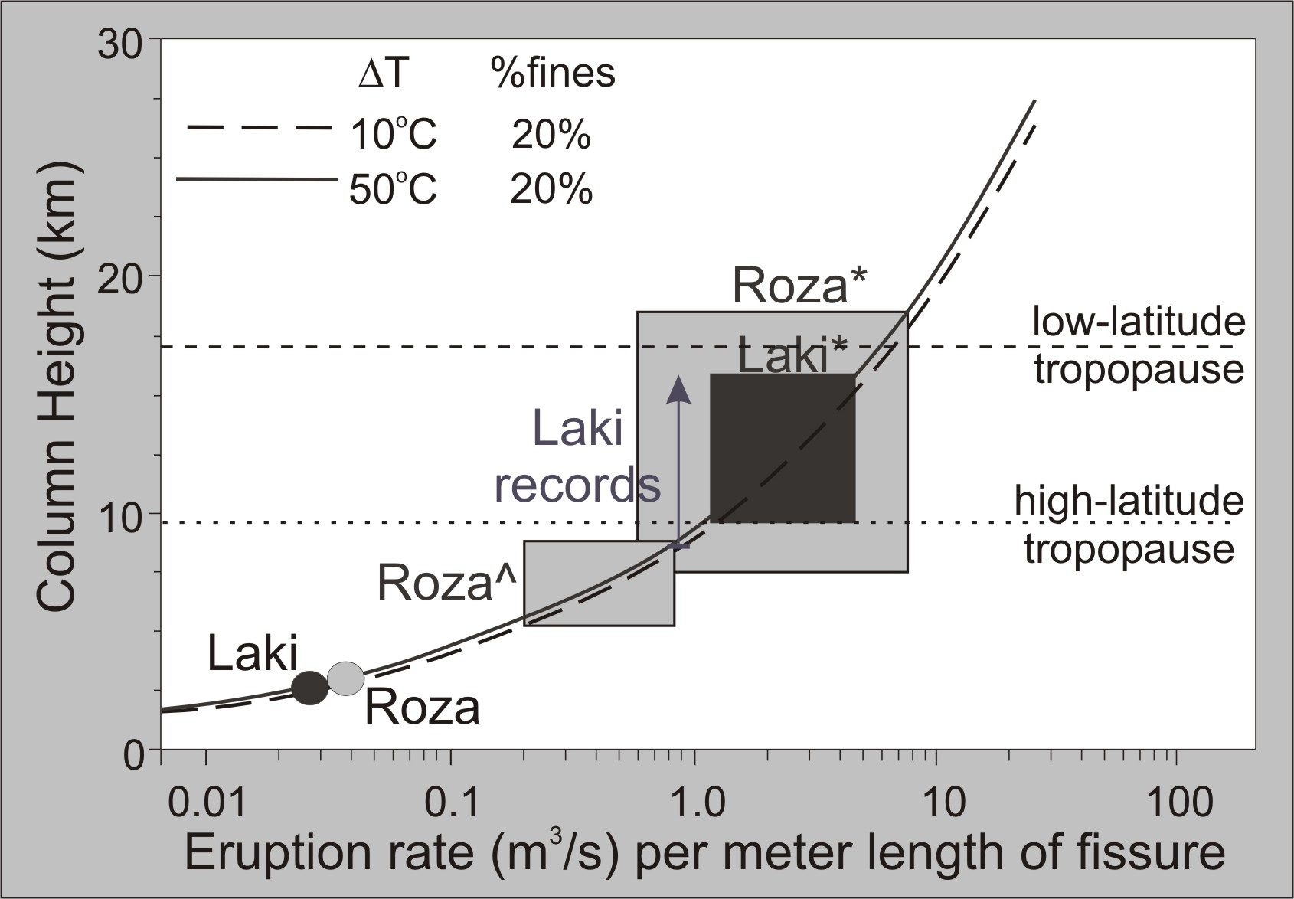
But expect only regional effects from flood basalt eruptions
HiRISE
MARCI
CTX
MCS
CRISM
Thordarson et al. (2009)

Slide 5
Missing link in the “kill chain”
HiRISE
Individual flood basalt eruptions pump out plenty of sulfur and other noxious gases to affect climate globally.
But the typical 10³-10⁴ m³/s eruption rates are not expected to inject the gases into the stratosphere – no direct global effect.
Sustained loading of the troposphere has severe regional/hemispheric impact but no well-understood mechanism to go global.
MARCI
CTX
MCS
CRISM

Slide 6
HiRISE
MARCI
CTX
Where can we find lava flows erupted at much higher rates than typical flood lavas on Earth?
MCS
CRISM

Slide 7


Slide 8
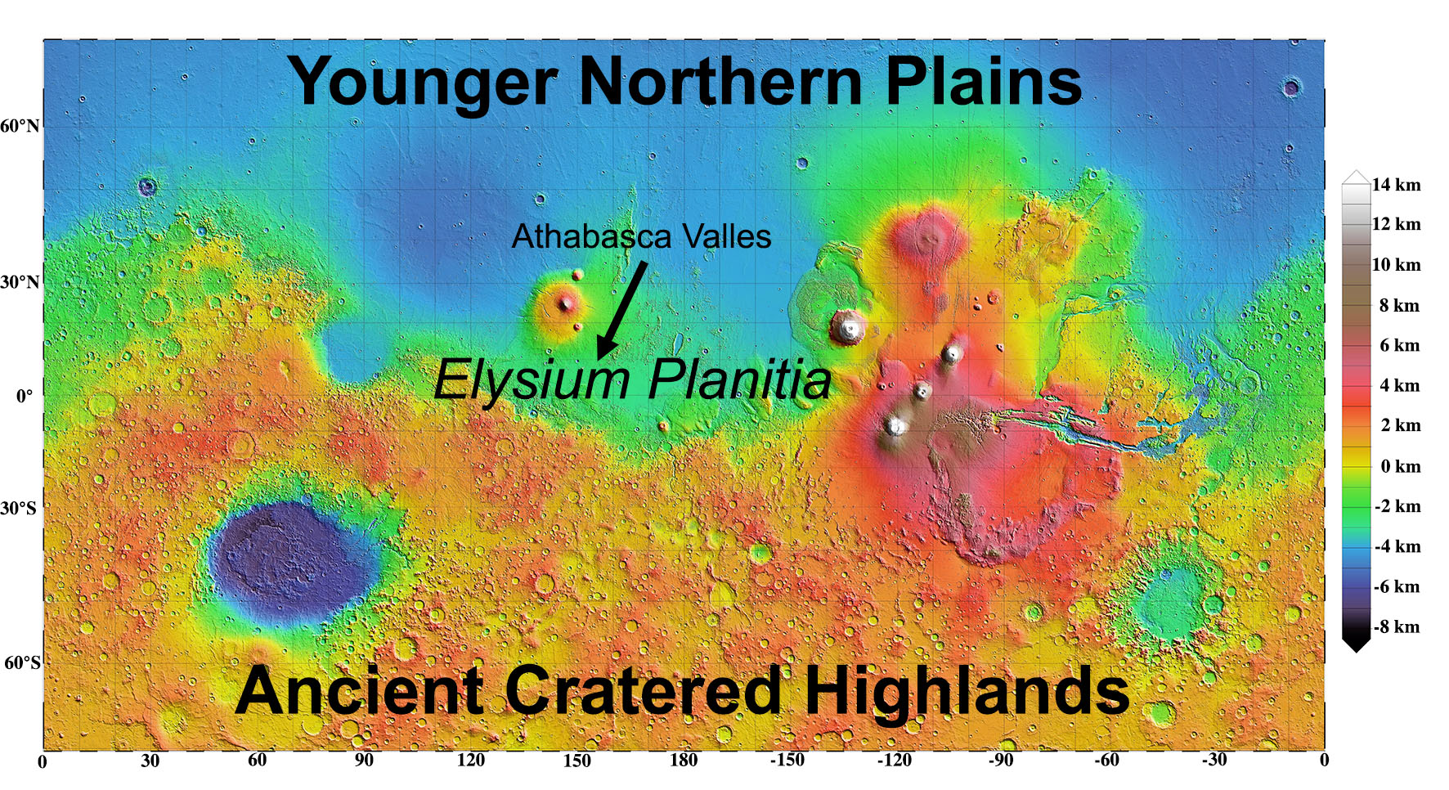

Slide 9
Athabasca Valles Flood Lava (Aav)
Youngest known eruption on Mars (~5Ma).
Exquisite preservation and exposure
Many aspects similar to typical individual flood basalt eruptions on Earth
  Vents are long fissures.
  Length is ~1400 km.
  Volume is 5000-7500 km³.

Slide 10
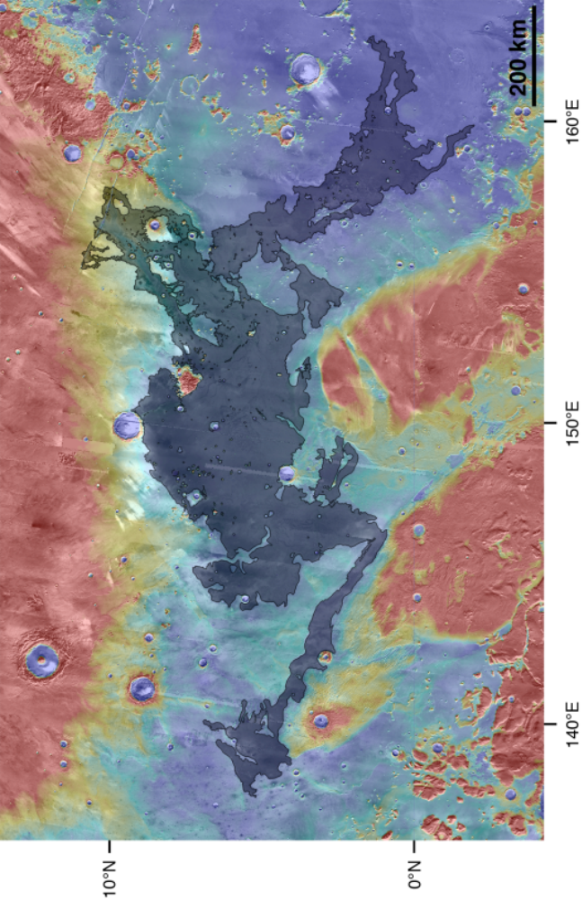
Aav – Full Extent

Slide 11
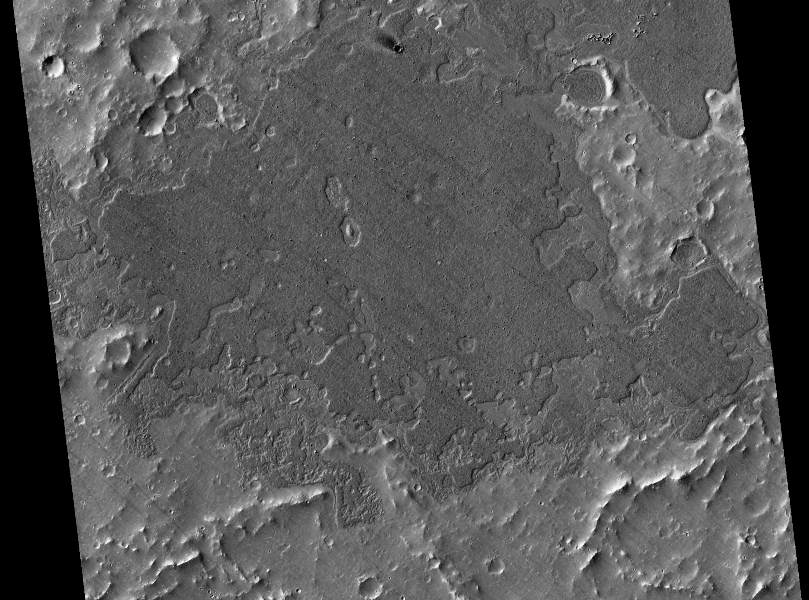
Aav – Distal Section

Slide 12
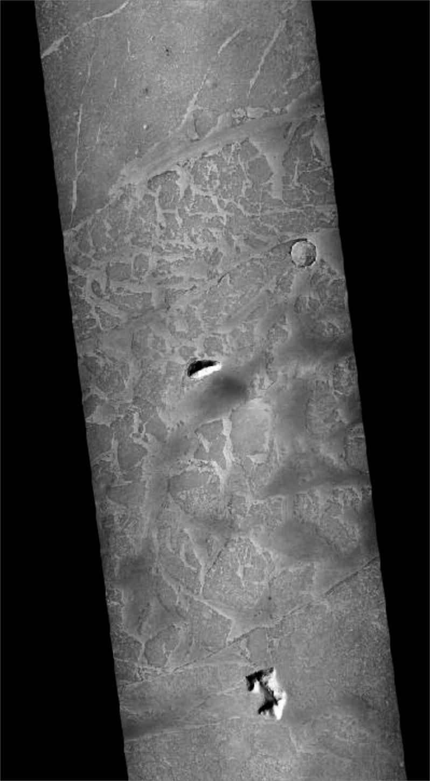
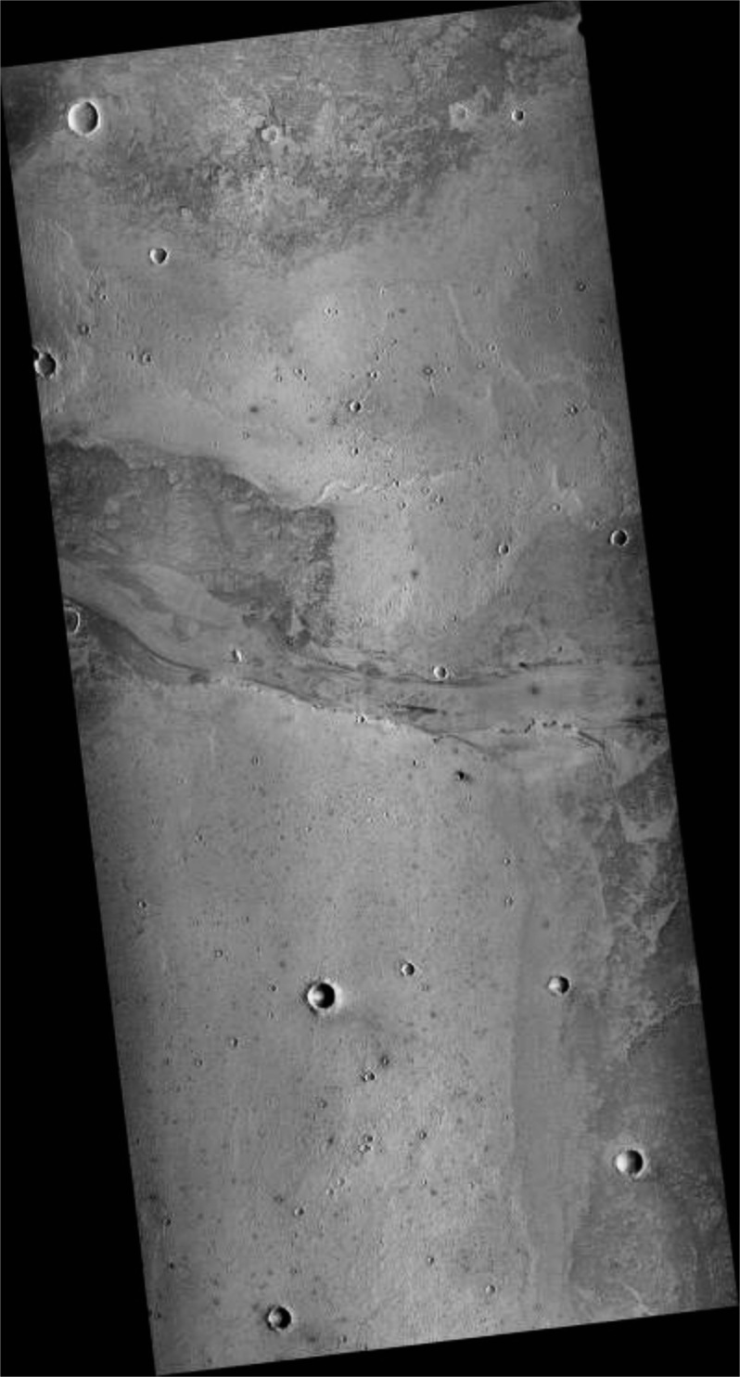
Aav – Medial Section

Slide 13
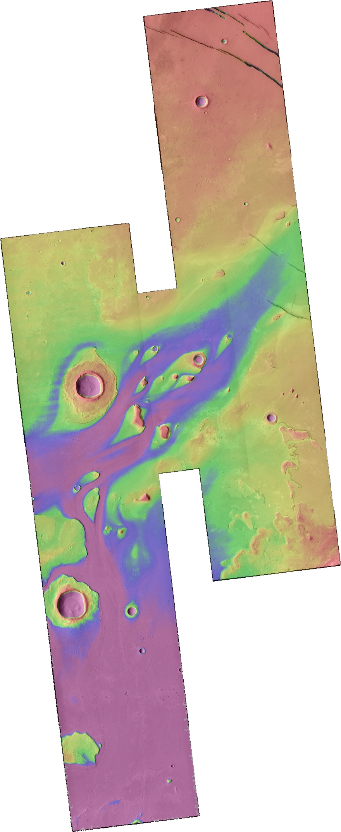
Near-Vent
Beautiful flood-carved channel
100% coated with lava
Lava coating only a few meters thick but high lava marks 100 m above the valley floor

Slide 14
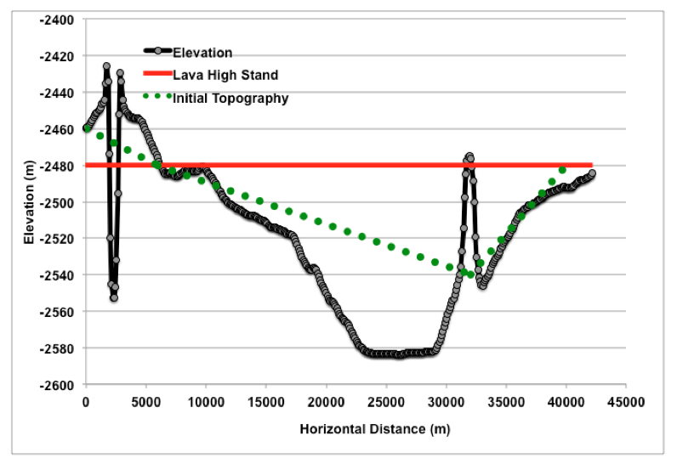
Aav – Lava Flux (part 1)

Slide 15
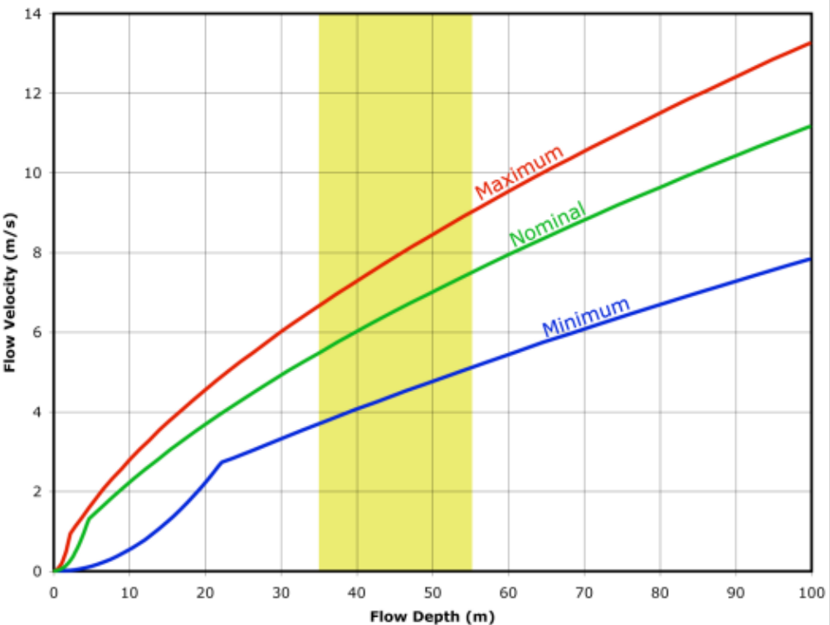
Aav – Lava Flux (part 2)
5-10 m/s velocity
~50 m deep
~30 km wide
10⁶-10⁷ m³/s
5000-7500 km³
Duration of “weeks”

Slide 16
Kasei Valles
Kasei Valles

Slide 17
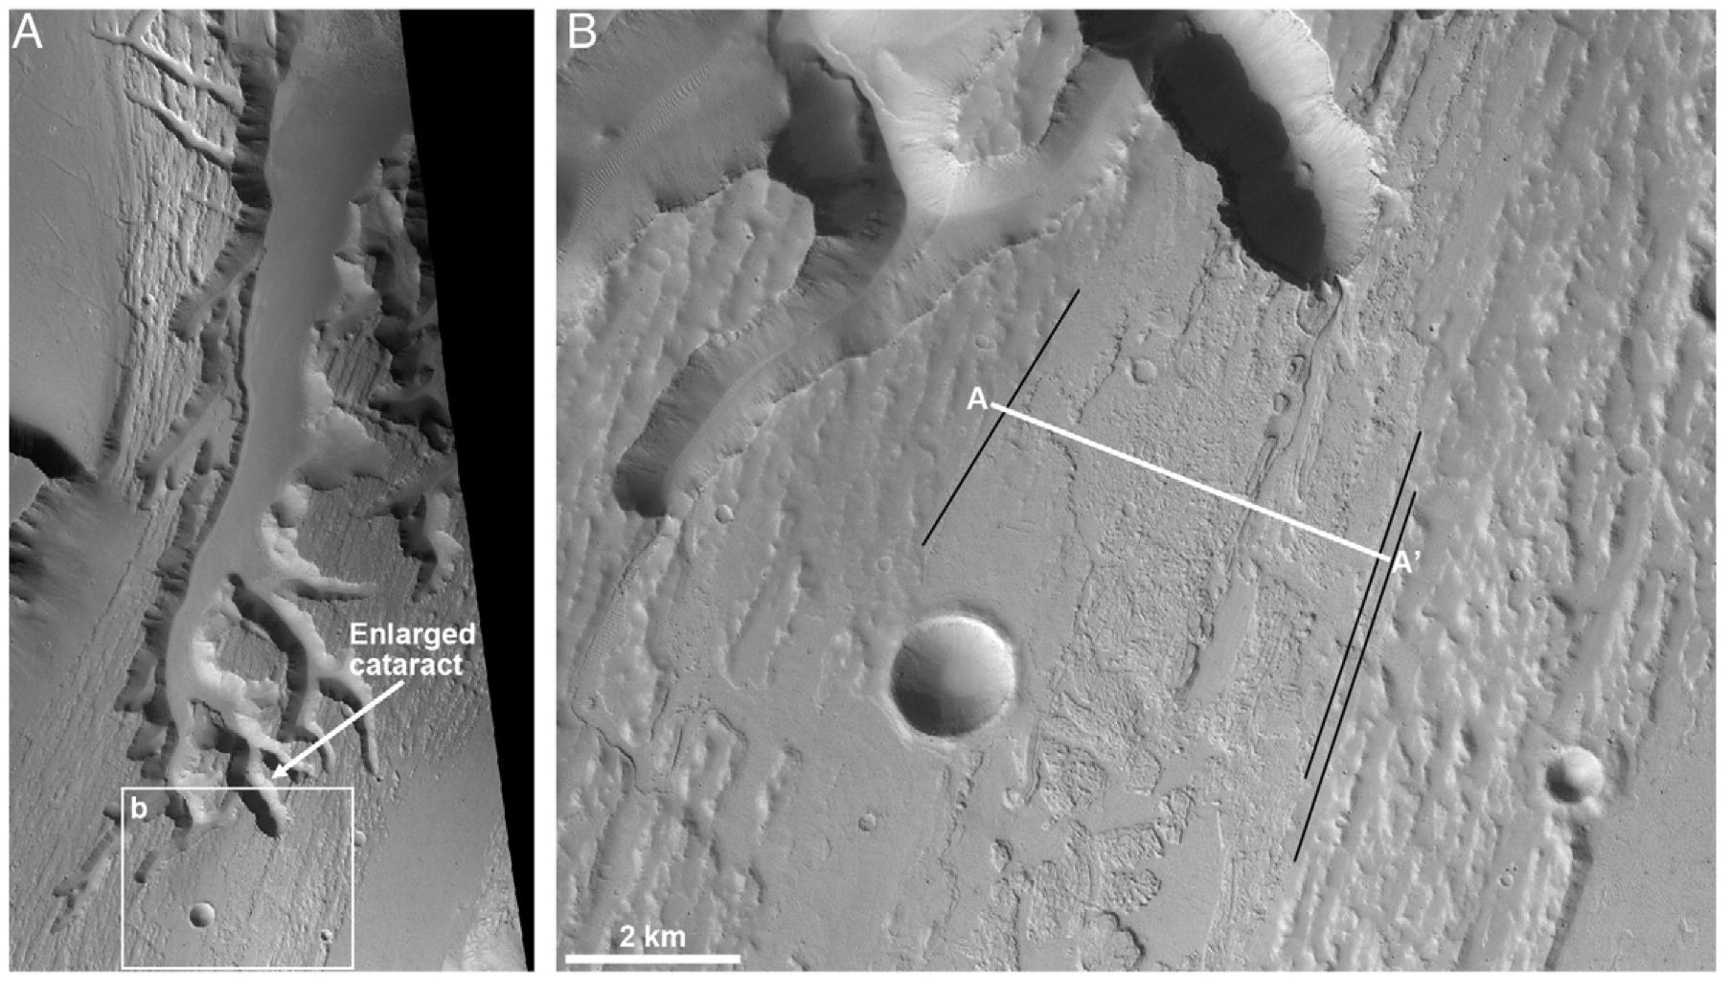
Kasei Valles – Lava Erosion

Slide 18
Diagnostic Features of Catastrophic Lava Floods?
Distal and medial sections do not have diagnostic features. Suggestive features include
  Extensive ponding
  Extensive pyroclastics
Erosion by lava and extensive deflation in the near-vent area appear to be diagnostic
  “Near-vent” can extend for hundreds of kilometers

Slide 19
Conclusions
The link between mass extinctions and flood basalts is a search for the rare catastrophic event within a flood basal province.
Vast, turbulent, erosive, catastrophic floods of lava could be such an event.
We should search for such flows on Earth…

Slide 20
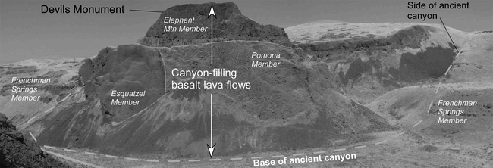
We seek a bigger version of this?
Bjornstad et al., (2007)

