Slide 1
PARADIGM SHIFTS IN GLOBAL
DISASTER POLICY 2015-2025:
A Changing Landscape for the Geosciences and Human Well-Being
Monica E Gowan, PhD
PO Box 7574, Rochester, MN, USA 55903
Email: monica.gowan@gmail.com
Ray C Kirk, PhD
School of Health Sciences, Private Bag 4800
University of Canterbury, Christchurch, New Zealand
Email: ray.kirk@canterbury.ac.nz

Slide 2
In the last 10 years we have moved away from viewing disaster as an event, and now see it as a rather long process. From the pressure of an increasing number of devastating events… a rapidly evolving understanding of risk has emerged… including financial and economic consequences.
Yet we are still behind the curve…
We must revitalize science and bring it back to the center of disaster risk reduction.
Margareta Walhstrom
UN Special Representative of the Secretary-General for Disaster Risk Reduction
Keynote Address (excerpted), Global Risk Forum/International Disaster and Risk Conference
Davos, Switzerland, 24 August 2014

Slide 3
A NON-LINEAR PATHWAY:
Towards Disaster Risk Reduction (DRR)
HISTORIC DEVELOPMENTS
Outcomes
1990, International Decade for Natural Disaster Reduction (IDNDR)
1994, Yokohama Strategy and Plan of Action for a Safer World
1999, UN International Strategy for Disaster Reduction (UNISDR)
2005, Hyogo Framework for Action (HFA)
2006, Global Platform for DRR
Increasing global disaster awareness
  Events are not new
  No person, place, or thing is invulnerable
  Disasters are not "just a Third World problem“
People and communities are increasingly expected to carry their own risk
Decision-makers may not use the best science
A "closer circle of dominoes“
  “Sophisticated, complex, and creative civilizations can be fragile and impermanent”
Notes:
1990, International Decade for Natural Disaster Reduction (IDNDR) – planning and management
1994, Yokohama Strategy and Plan of Action for a Safer World – coordination and prevention
1999, UN International Strategy for Disaster Reduction (UNISDR) – sustainable risk reduction
2005, Hyogo Framework for Action (HFA) – Building Resilience of Nations and Communities
2006, Global Platform for DRR – biennial forum on HFA strategic guidance and implementation
Disaster risk reduction (DRR) is a systematic approach to identifying, assessing and reducing the risks of disaster. It aims to reduce socio-economic vulnerabilities to disaster as well as dealing with the environmental and other hazards that trigger them: Here it has been strongly influenced by the mass of research on vulnerability that has appeared in print since the mid-1970s.[1] It is the responsibility of development and relief agencies alike. It should be an integral part of the way such organisations do their work, not an add-on or one-off action. DRR is very wide-ranging: Its scope is much broader and deeper than conventional emergency management. There is potential for DRR initiatives in just about every sector of development and humanitarian work.
The most commonly cited definition of DRR is one used by UN agencies such as UNISDR and UNDP: "The conceptual framework of elements considered with the possibilities to minimize vulnerabilities and disaster risks throughout a society, to avoid (prevention) or to limit (mitigation and preparedness) the adverse impacts of hazards, within the broad context of sustainable development."[2]
The United Nations General Assembly designated the 1990s as the International Decade for Natural Disaster Reduction (IDNDR).[1]
Its basic objective was to decrease the loss of life, property destruction and social and economic disruption caused by natural disasters, such as earthquakes, tsunamis, floods, landslides, volcanic eruptions, droughts, locust infestations, and other disasters of natural origin. (via National Disaster Management Plans)
Yokohama Strategy integrated prevention into risk management and fostered coordination of approaches from local to international levels
Three strategic goals of the Hyogo Framework for Action: Building the Resilience of Nations and Communities to Disaster: 1) integrating DRR into sustainable development policies and planning, 2) developing and strengthening institutions, mechanisms and capacities to build resilience to hazards, and 3) incorporating risk reduction approaches into emergency preparedness, response, and recovery programmes.
UNISDR leads the preparation and follow-up of the Global Platform for Disaster Risk Reduction, establishment in 2006 (GA resolution 61/198).
The Global Platform has become the main global forum for disaster risk reduction and for the provision of strategic and coherent guidance for the implementation of the Hyogo Framework and to share experience among stakeholders.
Other areas of work for UNISDR includes issuing the Global Assessment Report on Disaster Risk Reduction every two years, supporting countries in monitoring risk trends and the implementation of the Hyogo Framework for Action, and leading global campaigns on disaster risk reduction for safer schools, safer hospitals and safer cities.

Slide 4
More things are happening to you
That you never thought before
Would happen
To you.
Margareta Walhstrom, UN-SRSG,
GRF Forum/International Disaster and Risk Conference
Davos,, Switzerland, 24 August 2014
Towards a Post-2015 Framework for Disaster Risk Reduction ("HFA2")
"A Future-Focused Agenda with a Commitment to Outcomes
and Managing Risks in Future Decades"

Slide 5
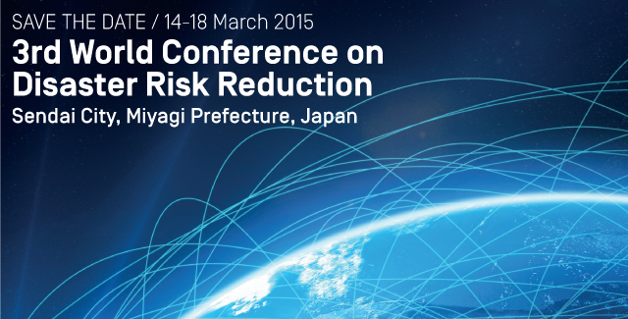
Upcoming:
3rd World Conference on Disaster Risk Reduction
www.wcdrr.org

Slide 6

AN EVOLVING DRR:
Towards Disaster Risk Reduction and Resilience (D3R)
EXCERPTS FROM THE CHAIR’S SUMMARY, 2013
The gravity of risk is escalating.
DRR is important in achieving Sustainable Development Goals,
tackling the impacts of climate change, and building resilience to extreme events.
The role of science and education is central to the efforts of governments and stakeholders.
Existing efforts to strengthen scientific information and evidence should be utilized in DRR.
Coordinated, consolidated approaches to scientific information and evidence are needed now and in the future.
The diversity, representation, and independence of science are important to D3R.
Notes:
ACTION AGENDA
Integrated research and scientific assessment of risk
International science advisory mechanism

Slide 7
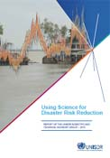
Science here is taken to include natural, social, economic, engineering, health and behaviour sciences as they pertain to disasters and disaster risk and to include the collection, assessment and communications of evidence on policy and practice.
“Disasters are taken to include those associated with natural and technological hazards and their interface with shocks associated with human conflict and economic and financial crises.”
Using Science in Disaster Risk Reduction, Report of the UNISDR Scientific and Technical Advisory Group (STAG), 2013 http://www.unisdr.org/files/32609_stagereport2013assembled.pdf

Slide 8
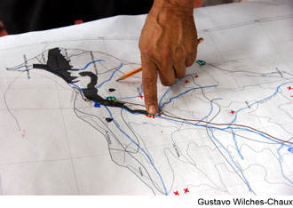
It is vital that research becomes more directly actionable, coupled with more effective ways of providing evidence-based advice to support disaster policy and practice.
“We call upon governments and other stakeholders … to support the implementation of an Action Agenda for an international science advisory mechanism for disaster risk reduction to strengthen resilience.”
Statement on Establishing an International Science Advisory Mechanism for Disaster Risk Reduction to Strengthen Resilience for the post-2015 Agenda, 27-28 March 2014 http://www.unisdr.org/partners/academia-research

Slide 9

What Resilience Is, and Isn’t

Slide 10
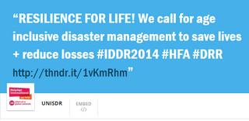
"Resilience Is for life"
Resilience is for people, places, organizations, knowledge systems, and decision-making
Monday, 13 October 2014, International Day for Disaster Reduction

Slide 11

"Resilience cannot be Restoration"
A KEY QUESTION:
WHAT IS IT THAT WE ARE PREPARING FOR?
  Planning for maintenance with minimal disruption?
  Or, normalizing risk?
    New risk burdens require successful functioning under a reduced
    "margin for error"
  Ability to manage and communicate expectations, uncertainty, variability, adversity
Institute for the Protection and Security of the Citizen, European Commission Joint Research Centre

Slide 12
"Resilience IS not an antonym for vulnerability, or a substitute for disaster risk reduction"
Resilience is highly complex, non linear,
and multidimensional
  “Qualities of resilient systems include behaviors that are not only robust and redundant, but reflective, flexible,
  inclusive, and integrated”
  Personal resilience is highly individual and integrative www.hqlo.com/content/12/1/85
  Parallels to resilience for ‘people, places, and things’ in other concepts and initiatives such as the "OneHealth" ecosystem paradigm
    ~ Jorn Birkmann, UNU Section Head, Extreme Events group
Branlio Morera, Arup UK

Slide 13
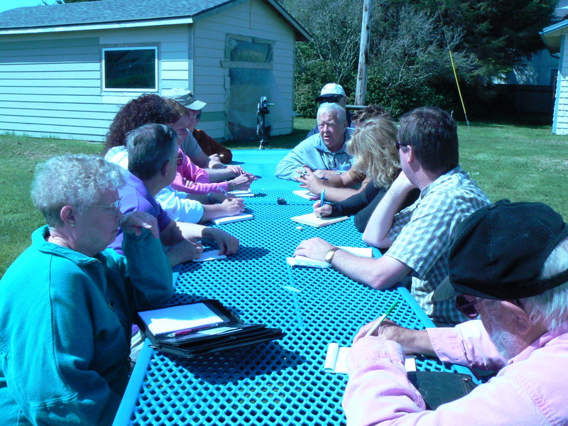
"Resilience Is for practice"
Prevention, preparedness, and readiness
are paramount for:
  Emergency Management
  Health and safety
  Security
  Service delivery
  Infrastructure
  Asset protection
  Continuity planning
  Urban planning
  Forecasting
ISDR
May 2008 Tsunami Evacuation Planning Focus Group, SW Washington Coast

Slide 14
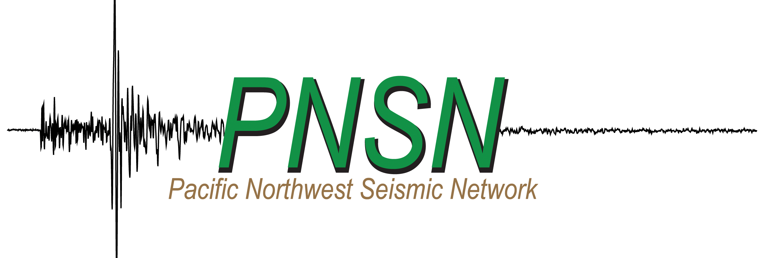

GEOSCIENCE ROLES – Foundational and applied science
Development and testing of novel theories and questions:
  Understanding causality, rates of change, variability, uncertainty, magnitude, intensity, frequency, persistence, compounding and amplifying effects
Measurement and Analysis:
  What are we measuring? What should we measure? How should we analyze the data?
Innovation and Translation to Practice:
  Early earthquake warning, tsunami monitoring
  GIS applications, e.g.., episodic tremor/slow seismic slip, evacuation planning

Slide 15
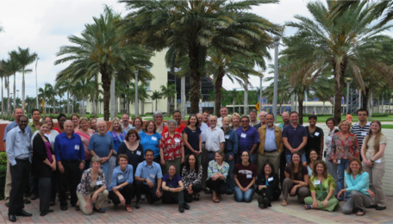

GEOSCIENCE ROLES –
Transforming research and education
Transdisciplinary Integration: Engaging in building
a common language around risk and resilience
  SERC InTeGrate Workshop on
  Teaching about Risk and Resilience
    Case Studies and Teaching Activities
    Teacher Mentorship and Training
  Cascadia Region Earthquake Workgroup
    Scenario Development and Outreach
  SERC InTeGrate Workshop Participants
  Florida Atlantic University, May 2014

Slide 16
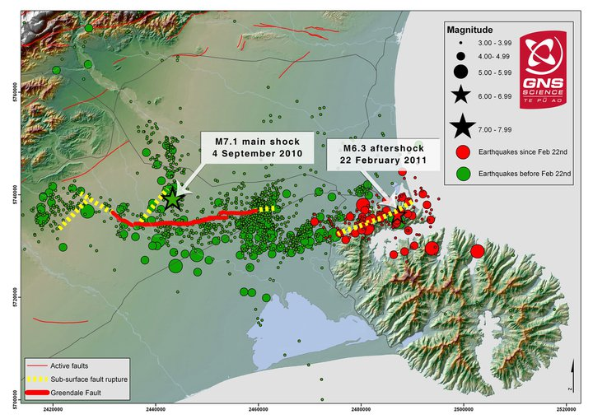
GEOSCIENCE ROLES –
Communications and public outreach
How to deploy and use information in civil society and in a financial and legal world?
  Interacting with insurance, banking/finance, commerce, industry,
  emergency management, service delivery
  Participating in the ethics of information and expectation management
    Professional settings:
      What needs to change? What would change?
    Public messaging
      What mediums?
      What messages?
      How to prepare the public? What to tell the public?
      How to convince people toward action and readiness?
Image by W. Ries and R. Langridge, GNS Science

Slide 17
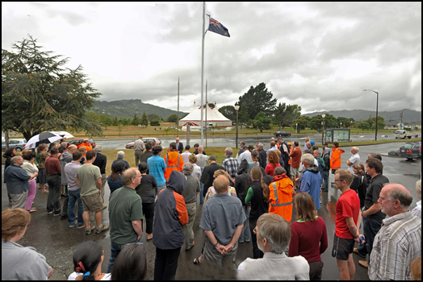
COMING FULL CIRCLE
Disasters are paradigm shifts in the way one views the world and one’s place in it.
While the landscape of one’s life may change, professional commitments to science and protection of well-being can yield meaningful and impactful outcomes.
Risk reduction and resilience is available to all.
The future is hopeful as global awareness and collaborative efforts grow.
Opportunities will abound for geoscientists to participate in building disaster risk reduction and resilience.
Minute of silence in remembrance of 22/2/2011 Christchurch Earthquake at GNS Science, Lower Hutt, New Zealand

Slide 18
ACKNOWLEDGEMENTS
- Byron Callies, Mayo Clinic Division of Emergency Management
- Ken Jones, City of Rochester Emergency Management
- Heidi Kandathil, Cascadia Region Earthquake Workgroup (CREW)
- Cathy Manduca, SERC InTeGrate Program, Carleton College
- Bob Nellis, Mayo Clinic Department of Public Affairs
- John Schelling, Washington State Emergency Management
- John Vidale, Pacific Northwest Seismic Network (PNSN)

Slide 19
References
2014, Gowan, M. Developing student literacy on risk, resilience and strategies for living with disaster uncertainty (teaching activity): Teaching about Risk and Resilience: Sea Level Rise, Flooding, and Earthquakes, SERC InTeGrate Workshop, Florida Atlantic University, Boca Raton, FL, May 2014
2014, Gowan, M. Disaster Resilience 2015-2025: what will it look like in Cascadia? (Case Study): Teaching about Risk and Resilience: Sea Level Rise, Flooding, and Earthquakes, SERC InTeGrate Workshop, Florida Atlantic University, Boca Raton, FL, May 2014
2014, Gowan, ME, Kirk, RC, and Sloan, JA, Building Resiliency: a cross-sectional study examining relationships among health-related quality of life, well-being, and disaster preparedness. Health and Quality of Life Outcomes, 2014 Jun 9;12:85 www.hqlo.com/content/12/1/85
2014, Gowan, ME, Kirk, RC, and Sloan, JA, Integrative Disaster Resilience: bringing well-being to disaster prevention and self-management of risk and uncertainty: Proceedings of the GRF/International Conference on Disaster & Risk Management, Davos, Switzerland, August 2014

Slide 20

Thank you.
Questions?

